Slide 1

Successful Chapter Sponsorship Programs

Slide 2
Topics for Today’s Presentation
Goals/Motivations of Sponsorship
Who Are Your Potential Sponsors?
Sponsorships vs. Advertising
Sponsorship Agreements: Forms vs. Contracts
Types of Sponsorship Programs
What to Include as Benefits…
Pricing Your Sponsorships
When to Market/Sell Your Sponsorships
Roles of Staff & Volunteers

Slide 3
Goals/Motivations of Sponsorship
One of the keys to any kind of sales is to understand the goals and motivations of your customers.
Some of the benefits of sponsorship include:
Increasing their return on investment.
Building business relationships.
Gain valuable insights from customers.
Expanding their content strategy.
Fostering a positive reputation.

Slide 4

Goals/Motivations of Sponsorship
6) Generating leads.
7) Reaching sales goals.
8) Benefitting from association.
9) Boosting brand visibility.
10) Engaging niche markets.
11) Showcasing a service or product.
12) Gaining a competitive advantage.
13) Interacting with prospects.
14) Establishing credibility.
  Source: Business Sponsorships: 14 Benefits of Sponsoring an Event
  Indeed Career Guide

Slide 5
Who Are Your Potential Sponsors?
The easy answer is….ANYONE!!!
Potential sponsors include:
Carriers
Broker/Dealers
Software Providers
Paramed Companies
Reverse Mortgage Companies
Educational/Coaching
Consultants
Lead Generation
Client Engagement Systems
Marketing Firms
Printers
Custom Tailors…and MORE!!

Slide 6
Sponsorship vs. Advertising
Advertisements are a paid, one-way marketing message promoting a brand. Sponsorships are collaborations, whereas brands fund events or activities in exchange for recognition.
Advertisements are overt sales pitches. Sponsorships enable subtle brand-building based on affinity and association with sponsored property.
Sponsorships generally enjoy greater deductibility than advertising as business expenses for companies.
Advertising is more likely to be considered Unrelated Business Income (UBI) for non-profit organizations.

Slide 7
Sponsorship Agreements: Forms vs. Contracts
Contracts clearly delineate the responsibilities of both parties and lay out clearly amounts due and in return for what benefits.
Contracts can be a turnoff for potential sponsors and companies may require legal review that could delay or derail the process.
Most organizations simply use a form to collect the necessary information and clearly explain the benefits to be received.

Slide 8
Types of Sponsorship Programs
A La Carte – Sponsor receives recognition for a specific event, element of an event, or purpose. This is the most common option and could include a hole at a golf tournament, a coffee break at a conference, or a logo on a website.
Package Deals – Contains a grouping of benefits around a single event, such as a golf tournament or conference, and is often recognized by levels of costs and benefits.
Annual Agreements – Contains a grouping of benefits for the year and is often recognized by levels of costs and benefits.

Slide 9
What to Include as Benefits…
ANYTHING YOU CAN THINK OF!!!

Slide 10


Slide 11
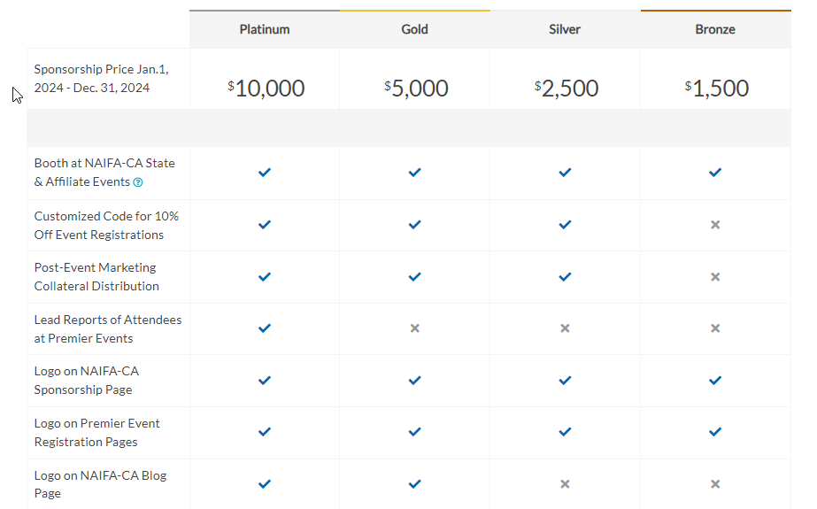

Slide 12
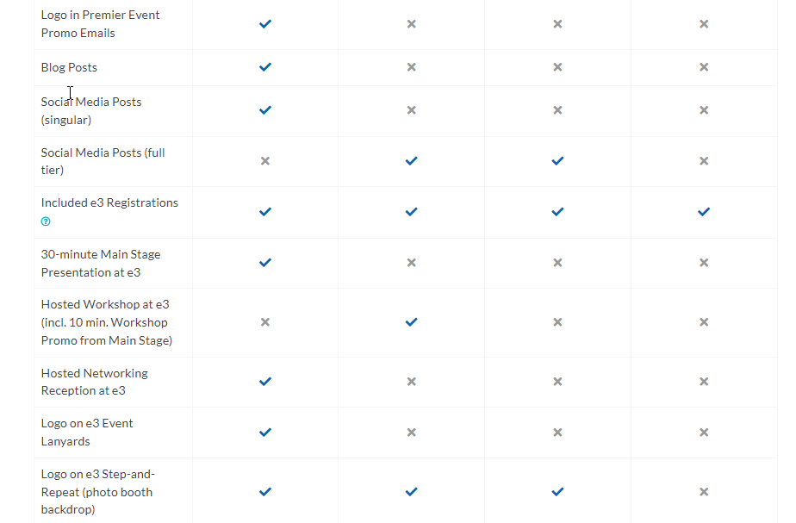

Slide 13
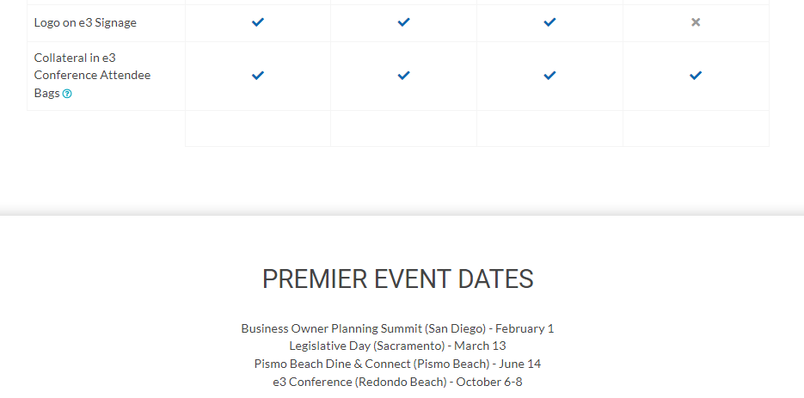

Slide 14


Slide 15
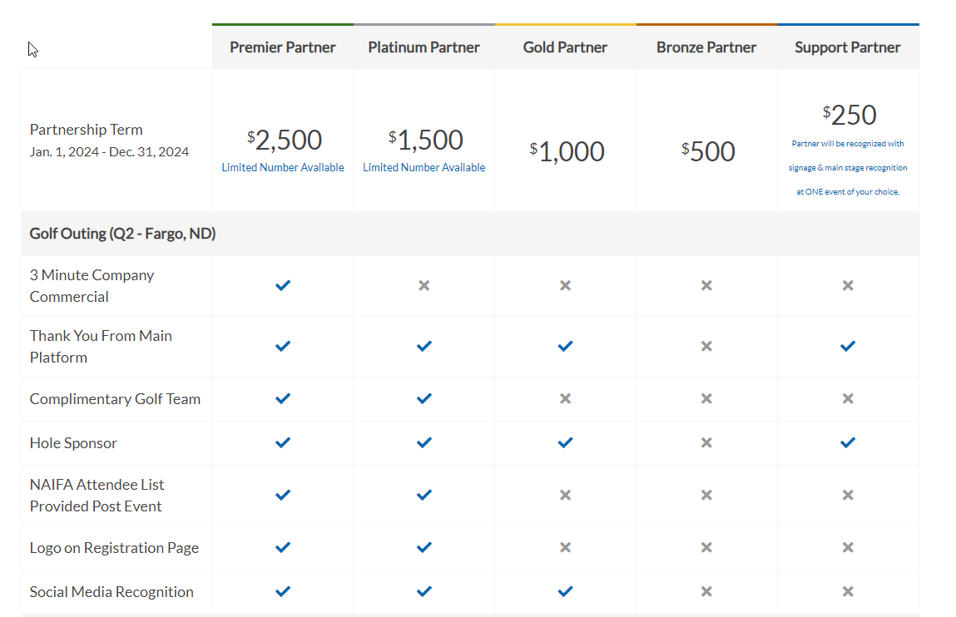

Slide 16
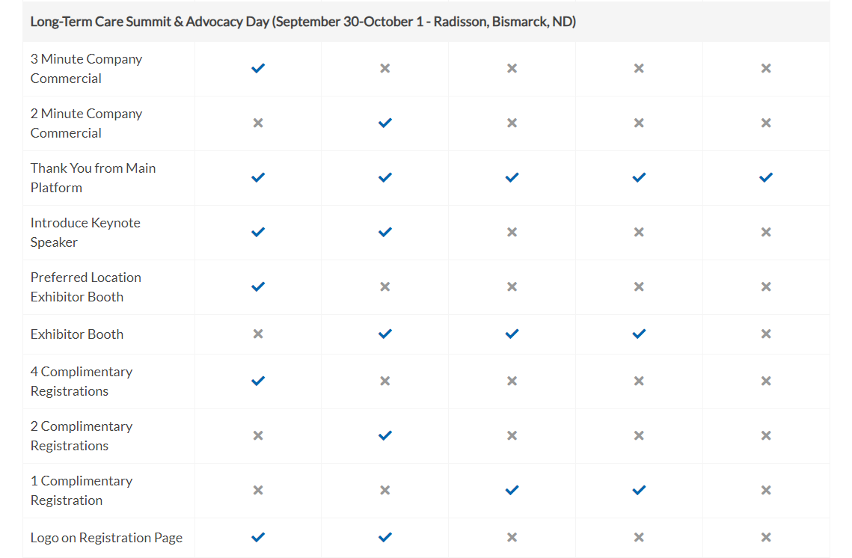

Slide 17
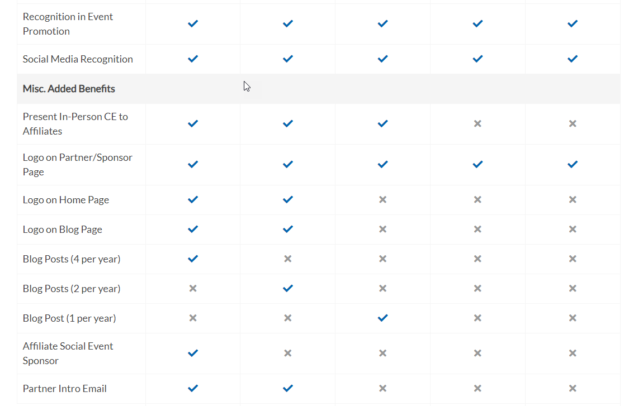

Slide 18


Slide 19
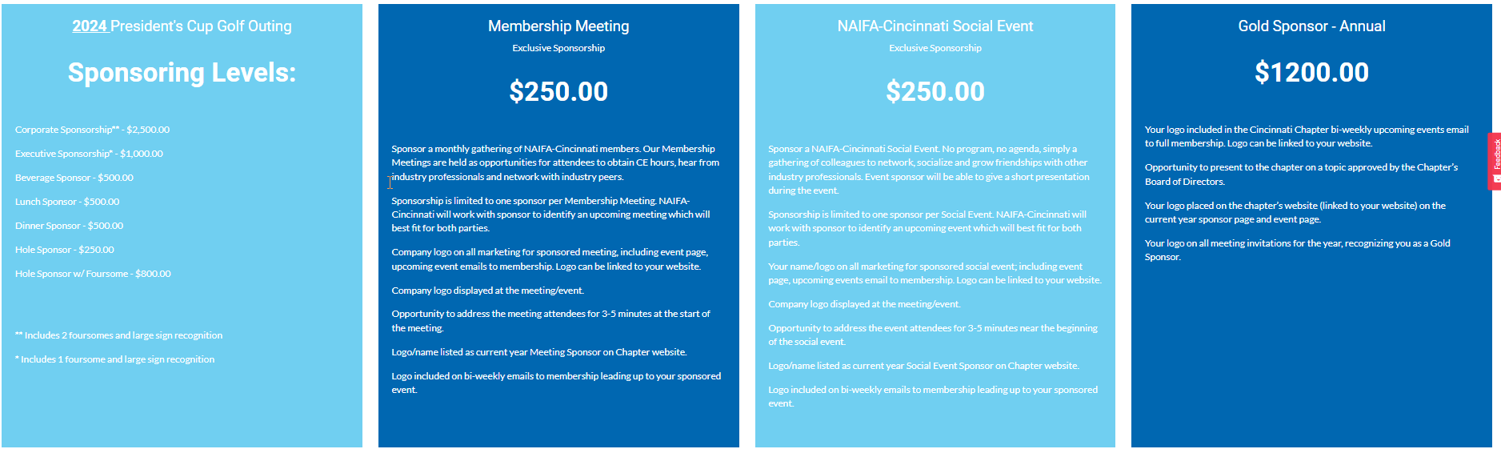

Slide 20
Pricing Your Sponsorships
Pricing a sponsorship is an inherently subjective process.
In choosing your pricing, consider the following:
  Cost of any benefits you are providing (fixed and sunken costs).
  Historical value of any sponsorships you have offered.
  The size of your membership and the potential value to sponsors.
  What other similar sized NAIFA Chapters may be charging.
  What other similar sized associations in your area may be charging.
  What the market will bear.

Slide 21
When to Market/Sell Your Sponsorships
The easy answer is….ALL THE TIME!!!
However, there are some strategic times to consider
  Companies are putting together their budgets at the beginning of Q4 and it is ideal to get them to plan and include an investment in your sponsorship at that time.
  For event-specific sponsorships, they often like to have some idea of the dates, location, expected attendance, types of attendees/lines of authority, and the programmatic details so they can better assess the value to their company.

Slide 22
Roles of Staff & Volunteers
Staff
  Recommend a sponsorship structure, benefits, and pricing to the Board for their consideration.
  Prepare documentation and marketing materials to send to companies to promote the sponsorships, as well as contracts or forms needed to accept sponsorships.
  Send the marketing materials and promotions out to potential sponsors.
  Receive, process, and deliver promised benefits to the sponsors.
  Thank sponsors for their support and solicit them for future and increased sponsorship levels.

Slide 23
Roles of Staff & Volunteers
Volunteers
  Identification of potential sponsors and key contacts. This can be done by asking Board members and volunteers to provide a list of all the organizations that they do business within the jurisdiction of your Chapter.
  Outreach and follow-up with potential sponsors and key contacts to let them know that their support is important to you and make the personal ask/close the deal.
  Thank sponsors for their support and solicit them for future and increased sponsorship levels.

Slide 24



Together We Can Take On Anything

