Slide 1
Instructions for Chapter Customization
Greetings Chapter Staff!
This Board Orientation has been carefully developed to assist you in educating your board on their roles and responsibilities, as well as to help them understand those that are more appropriately left to staff.
It is our belief that this tool will aid in the board being more focused on their strategic and oversight roles, rather than getting stuck in the weeds, as we heard described by Bob Harris, CAE during our Blueprint Training. If they haven’t seen that, I would encourage them to do so before you do this presentation.
Additionally, we would encourage you to supplement this presentation with the materials recommended as part of the NAIFA Model Chapter Board Manual.
Notes:
Note: Remove this slide before Board Orientation.

Slide 2

Governing Responsibilities
A Board Orientation for NAIFA-[Insert Chapter Name]
[Insert Date]

Slide 3
Purpose of Board Orientation
To understand governance and the governing documents.
To understand staff’s management role.
To focus on the strategic direction, mission and goals of the organization.
Fiduciary duties; the trust of members in the board of directors.
Awareness of the organization and its resources (finances and people).
Risk awareness and avoidance.

Slide 4
Board of Directors
President – [Insert Name]
President Elect – [Insert Name]
Immediate Past President – [Insert Name]
Secretary/Treasurer – [Insert Name]
Membership Chair – [Insert Name]
Advocacy Chair – [Insert Name]
Programs Chair – [Insert Name]

Slide 5
Chapter Organizational Chart (For State Chapter Use)
Executive Committee
President
President-Elect
Immediate Past President
Secretary
Treasurer
Executive Director (ex-officio)
State Committee Chairs
Advocacy Chair
IFAPAC Chair
Candidate Selection Chair
Grassroots Chair – Federal & State
Membership Chair
Young Advisors Team (YAT) Chair
Diversity Advisor Team (DAT) Chair
Programs Chair
LILI Chair
Optional Leadership Positions
Business Development
Community Relations
Social Media
Member Engagement
Sponsorship
Volunteer Program

Slide 6
Chapter Organizational Chart (For Local Chapter Use)
Executive Committee
President
President-Elect
Immediate Past President
Secretary
Treasurer
Executive Director (ex-officio)
Local Committee Chairs
Advocacy Chair
IFAPAC Chair
Grassroots Chair – Federal & State
Membership Chair
Young Advisors Team (YAT) Chair
Diversity Advisor Team (DAT) Chair
Programs Chair
LILI Chair
Optional Leadership Positions
Community Relations Coordinator
Social Coordinator
Member Engagement Coordinator
Volunteer Coordinator
Sponsorship Coordinator
Diversity Coordinator

Slide 7
Governance in Non-Profits
Winning is easy - governing is hard.
-George Washington
Management is doing things right. Leadership is doing the right things.
-Peter Drucker

Slide 8
Common Myths
These are myths often heard from board members:
We can’t lobby.
We can’t make a profit (excess revenue).
We can’t have a savings reserve.
Our records (or meetings) are open to the public.
Be alert to these myths before they take hold in the organization.

Slide 9
Not-for-Profit Status
Not-for-Profit is a designation; it should not influence how the organization does business.
The state in which the organization is registered grants not-for-profit status.
Authority is granted by the state to the board to govern in accordance with law.

Slide 10
The Governing Documents
Mission – Statement submitted to the IRS.
(Supplemented with vision and values statements.)
Articles of Incorporation – Authority from State Government.
Bylaws – Relationship between Board and Membership.
Policies – Wisdom passed along from prior boards.
Strategic Plan – Roadmap for the Board.

Slide 11
Mission Statement
The mission of the National Association of Insurance and Financial Advisors is “Empowering financial professionals and consumers through world-class advocacy and education.”
Purpose for existence. (Note: Mission, vision and values combine to create a brand for the organization.)

Slide 12
Vision Statement
Our 21st Century Vision
NAIFA is the home for professionals who serve a broad array of the American public's financial services needs. We have grown with the times, joining with the Society of Financial Service Professionals to expand our membership base and secure our position as an industry leader in education and professional development. NAIFA has brought on Life Happens, the leading source of highly impactful consumer information in the industry, to bolster our public outreach, promote the essential work done by our members, and educate the public on the vital products and services NAIFA members provide.
NAIFA continues as the foremost advocacy association in the insurance and financial services industry. With members in every Congressional District, our influence in Washington, D.C., and every state capital is unmatched. Our prestige, tremendous grassroots influence, and highly rated political action committee protect the ability of financial professionals to work in the best interests of the consumers they serve.
These three iconic brands in the insurance and financial services industry have joined together to assure the success of all industry professionals and promote the financial security of American families and businesses.

Slide 13
Values Common to Good Governance
Accountability
Transparency
Responsiveness
Participation
Respect (ideas and people)
Integrity
Effectiveness

Slide 14
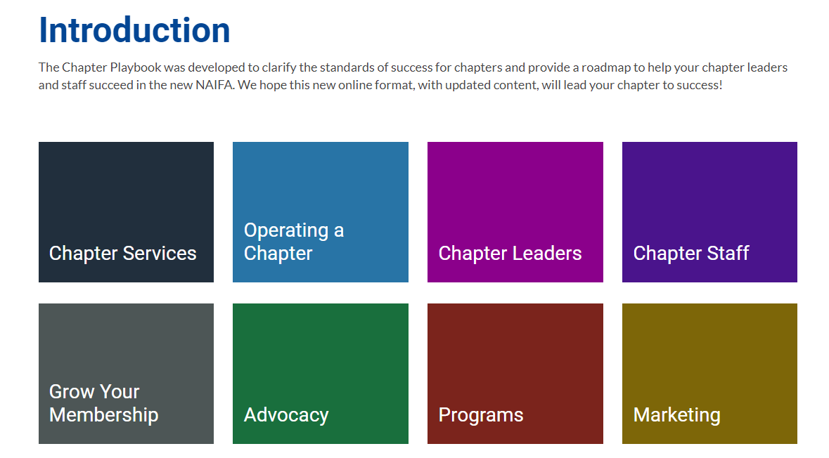
NAIFA Chapter Tools
Chapter Playbook
  https://leaders.naifa.org/chapter-playbook
NAIFA Blueprint Leadership Training
  https://leaders.naifa.org/naifa-blueprint-leadership-ondemand
Chapter Leaders Blog
  https://leaders.naifa.org/blog

Slide 15
Chapter Services Team
Corey G. Mathews, CAE
VP of Member and
Chapter Services
cmathews@naifa.org
Justi Folladori
Director of Chapter Services
jfolladori@naifa.org
Kaila Wilson
Chapter Services
Manager
kwilson@naifa.org

Slide 16
Board Staff Relationship
It requires a partnership between board and staff to advance the mission and goals.
Understanding and respecting the distinct roles and responsibilities is key.

Slide 17
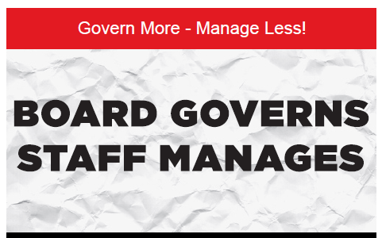
Remember the Adage

Slide 18
Leadership Team
The partnership includes the board (governance) and professional staff (management).
Both are on the leadership team.
Governance
(Board)
Management
(Staff)
Leadership

Slide 19
The Purpose of a Board
All corporations have a board. Its primary purpose includes:
Governance of the organization (not management).
Set a strategic direction (strategic plan).
Set policies and positions.
Protect assets.
Represent stakeholder/member interests.
Fiduciary responsibilities.

Slide 20
Fiduciary Principles
Duty of Care
  Good business judgment at all times.
  Due diligence in decision making.
  Ask the right questions.
Duty of Loyalty
  Act in best interest of organization and membership.
  Avoid conflicts of interest and personal interests.
Duty of Obedience
  Faithful to the mission and goals.
  Follow the governing documents.

Slide 21
Purpose of Management (Staff)
Execute the decisions of the Board.
Support volunteer efforts.
Administer daily details.
Monitor and report on progress.
Manage organizational affairs, personnel and property.
Official filings as necessary.

Slide 22
Board Responsibilities
Establish long-term strategic plan (3-5 years) and shorter-term priorities to achieve.
Determine association policy and positions.
Monitor resources through budget process.
Ensure progress.
Promote the organization (as authorized).
Relationship with executive director, attorney and CPA.

Slide 23
Expectations of Board Members
Attend all board meetings.
Start and end meetings on time.
Study and understand the mission statement, bylaws, strategic plan and Board Manual.
Prepare by reviewing the agenda and supporting documents.
Stick to established agendas.
Treat information and discussions as “confidential.”
Be respectful of people and ideas.
Notes:
Note: It is NAIFA’s recommendation that each Chapter have a Board Manual. This presentation should serve as a high-level overview of key points, whereas the Board Manual goes into detail on each point.

Slide 24
Expectations of Board Members (continued)
Promote our organization to others. (Though you cannot speak for the organization without authority.)
Recruit future leaders.
Stay current on issues and trends impacting the organization and the membership.
Volunteer for committees and other activities.
Communicate with staff for needed information and assistance.

Slide 25
The Executive Committee
Authorized by the bylaws to make time-sensitive decisions between meetings of the board.
Generally, includes the Officers.
Should not usurp authority of the board.
Actions are reported to the full board.

Slide 26
Financial Oversight
Protect all assets.
Development and approval of annual budget.
Review and “acceptance” of financial reports.
Safeguards and an audit process in place.
Review of IRS Form 990 prior to submission.

Slide 27
Recruiting Leaders
Identify and develop future leaders.
Tremendous need for diversity in thought, experience, location, products and personal characteristics.
Ask prospective leaders to serve or observe.
Nominating, or Governance Committee, plays a key role, as does every board member.
Provide education for future and evolving leaders.
Create the ideal leadership experience.

Slide 28
Board Meetings
Come Prepared
Have Fun, Relax
Open to Ideas and Learning
Ask Questions
Your Role is as a Director (not personal)
Envision the Future (long-term)
Respect People and Ideas
Arrive and End on Time (Board Meetings will be held [Insert Dates] at [Insert Time].)

Slide 29
Conflicts of Interest
The IRS expects directors to disclose conflicts of interest at least annually, as well as regularly and consistently.
The policy is suggested by the IRS.

Slide 30
Confidentiality
Meetings are a safe place for open discussions without fear of information leaking.
Directors have authority from gavel to gavel, but they do not speak for the organization unless specifically asked or designated.
Do not usurp the chief elected officer’s authority to speak for the organization.

Slide 31
Measuring Performance
Everything can be measured.
When recommendations come before the board, be ready to ask, “How will we measure and evaluate whether or not it is successful?”
Integrate performance metrics into recommendations and motions.

Slide 32
Board Meetings
Purpose is to conduct board business (not to perform committee or staff level work).
Directors are expected to attend duly called meetings.
Directors prepare for meetings, ready to make knowledge-based decisions.
Identify how and when to offer input to the agenda development.

Slide 33
Developing the Agenda
Prepared in collaboration between chief elected and chief staff positions.
To suggest items during agenda development, identify the process and protocols.
Agendas and all supporting documents sent in advance so directors can prepare.
Sample board agendas can be found at https://leaders.naifa.org/chapter-playbook-boardmeeting.

Slide 34
Meeting Minutes
Minutes are a record of the actions of the board.
They are not a record of conversations, notes or a newsletter for members.
Minutes are treated with confidentiality.
Audio recordings are discouraged and should not be retained.

Slide 35
Rules of Order
Rules ensure orderly meetings and a focus on advancing the board agenda.
In general:
Majority rule. (To have a quorum, the bylaws require [Insert Number] board members present.)
Dissent or opposition may be heard and noted if requested.
Ask the chief elected officer to be recognized.
Only one main motion heard at a time.
Roberts’ Rules or another form will be adopted to guide the board.
After the meeting, all directors support the decision of the board.

Slide 36
Guests at a Board Meeting
A respected organizational principle is Transparency. There are many ways to be transparent. Some organizations allow guests to attend board meetings.
It is important to have a policy and protocol for guests. For example, confidentiality, right to speak, no voting and respecting the board’s need to go into executive or close-door session.

Slide 37
Strategic Direction
Serves as a roadmap for 3 to 5 years.
Communicates relevance for stakeholders, answering, “What do you do for me?”
Board conversations should focus on strategic goals.
Committees advance elements of the strategic plan.

Slide 38
Committee Dynamics
Supplement the work of board and staff.
Opportunities to engage members and identify future leaders.
Have no authority to act on behalf of board or organization.
Expected to produce results advancing elements of the strategic plan.
Each with a specific purpose statement and current year charges.
Supported by liaisons from board and/or staff.
Understand performance measures set for the committee to meet.

Slide 39
Risk Awareness
Five ways boards may be protected from risk and liability.
Orientation, understanding their responsibilities and the governing documents.
D & O Liability Insurance
Corporate Veil
Indemnification
Voluntary Immunity

Slide 40
Risk Management
Some risks the board should be aware and avoid:
Copyright Violations
Discrimination
Harassment
Embezzlement
Required Filings and Reporting
Labor Law Compliance
Personal and Property Injury
Antitrust
The board should guard against risks in the organization.

Slide 41
Public Records
Most nonprofits are private corporations. It is erroneous to believe they fall under open record or Freedom of Information Act (FOIA) requests.
Compliance is expected with public records request of board or staff. Public records include:
  IRS Letter of Designation
  IRS Form 990 (last 3 years)
  IRS Form 1024 or 1023 (the application to requesting exemption)
IRS Form 990 can be found at www.Guidestar.org.

Slide 42
Risk Management – Antitrust
Antitrust avoidance statement on file and annual acknowledgements from each board member.
Every staff, board and committee member should be aware of the policy and take immediate action in any setting where a violation is occurring. Most common threat is discussions of price-setting among competitors that could be interpreted as an effort to restrict trade.
Staff monitors on-line discussions and meetings for potential violations.
Up to $10 million fine + damages + jail.

Slide 43
Risk Management – Who Speaks?
Apparent Authority – Care should be taken that committee chairs or other volunteers not usurp the authority of the chief elected officer or take on authority not specifically delegated.
“I can’t speak for the board, but I can offer my personal opinion.”

Slide 44
Risk Management – IRS Issues
IRS Issues
  Increasing scrutiny of boards and staff
  Unrelated Business Income Tax (UBIT)
  990s is public information
  Policy considerations
    Whistle Blower
    Audit
    Conflicts
    Record Retention
    Compensation

Slide 45
Summary
The board experience should be positive.
The board is the caretaker of the organization.
The board speaks as a whole (through the chief elected officer or designee).
Directors should apply their business acumen.
Directors are perceived as representing the organization.
Staff is the resource to the board to execute the strategic plan.
Please offer ideas to improve board and governance.
Thank you for serving on the board!

Slide 46
Calendar of Events
List all Affiliate, Local, State and National Chapter events.

Slide 47
Social Media
List Chapter Social Media including Facebook, Twitter, LinkedIn, Instagram, YouTube, etc.

