Slide 1

Building Your Bench:
Successful Succession Planning

Slide 2
Topics for Today’s Presentation
Purpose & Responsibility of Succession Planning
Generational Challenges
Why is it Difficult to get Members Involved?
Who are Your Potential Volunteers?
Develop a Succession Planning Policy
Role of the Governance Committee
How to Engage Potential Leaders
Strategies for Succession Planning
Tools & Resources
Training, Education, & Support
Volunteer Appreciation

Slide 3
Purpose & Responsibility of Succession Planning
The purpose of succession planning is to ensure the Chapter’s sustainability by continually recruiting and preparing the next generation of chapter leaders. Chapters will ideally have at least two years of succession planning in place.
Succession planning is the specific responsibility of the Chapter’s Nominating Committee, but also is the collective responsibility of all current chapter leaders, including its Board of Directors.

Slide 4


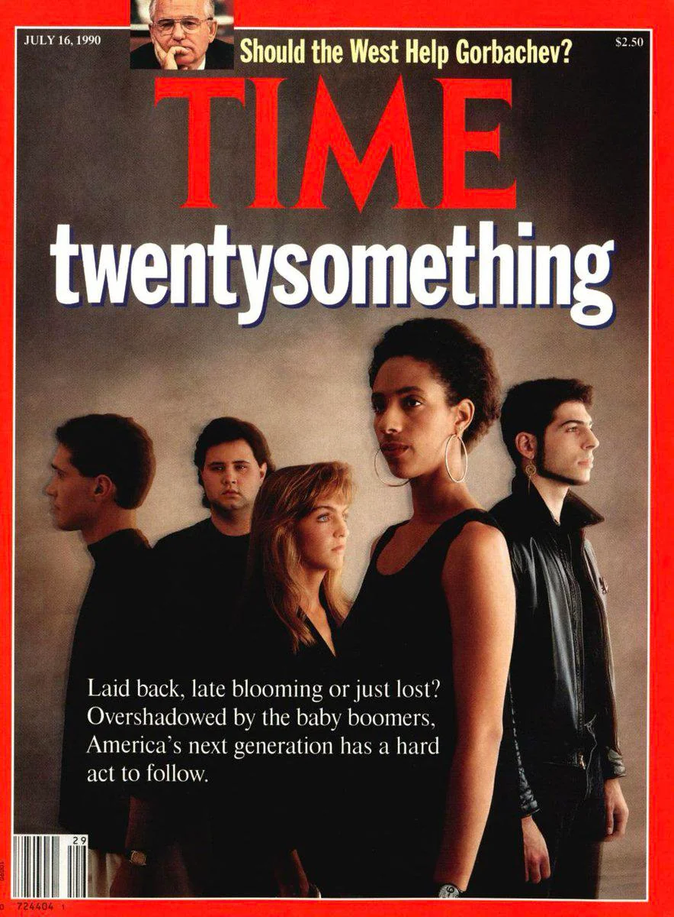
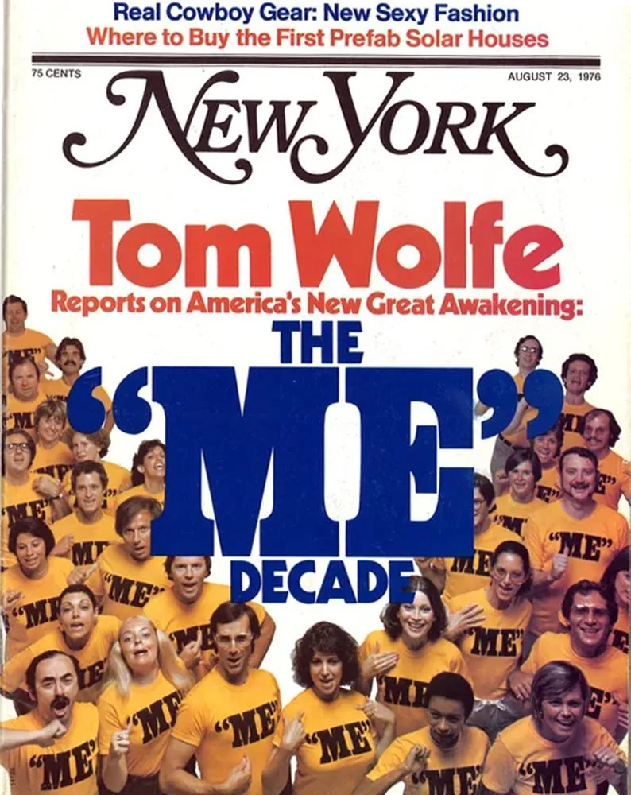
Generational Challenges
Notes:
Maclean’s 2023
Time 2012
Time 1990
New York 1976

Slide 5
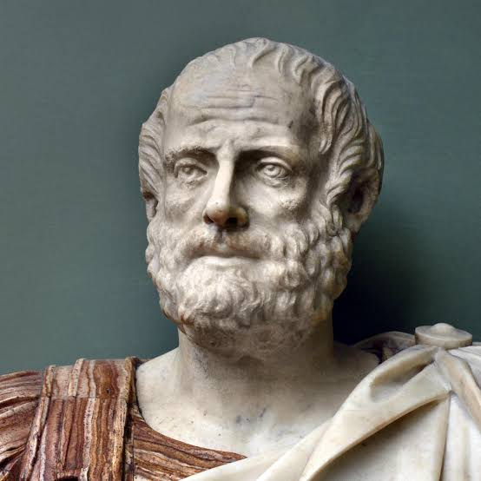
- Aristotle, 4th Century BC
“[Young people] are high-minded because they have not yet been humbled by life, nor have they experienced the force of circumstances.
…
They think they know everything and are always quite sure about it.”

Slide 6
Generation Z
The first generation to grow up entirely in the digital age and are expected to account for 27% of the workforce by 2025. Gen Zs are different from previous generations because they are:
Tech savvy
Have high expectations for their employers
View the career ladder as outdated
Quick to adapt and open to learning new things
More likely to evaluate a company's social media
presence, impact, values and organizational culture
before committing
Health conscious
Pragmatic
Question everything and everyone

Slide 7
Generation Z - Volunteerism
The Best Way to Engage Gen Z as Volunteers:
Offer flexible volunteer opportunities
Make sure your Calls-to-Action are clear and to the point
Develop a solid presence on digital platforms
Offer skill development opportunities through volunteering
Utilize technology to engage volunteers and make it easy

Slide 8
Why is it Difficult to get Members Involved?
You Don’t Have a Plan
You’re Asking too Much
They Don’t See a Reward
It Doesn’t Look Like Fun
They Believe Someone Else will Do It
They Don’t Want to Get Stuck
They Don’t Want to Wait Their Turn
NO ONE ASKED THEM! The #1 Reason People Don’t Volunteer!

Slide 9




The Four Basic Motivators
Notes:
Joy/Pride
Fear
Embarrassment/Guilt
Envy/Greed

Slide 10
Who Are Your Potential Volunteers?
EVERYONE!!!

Slide 11
Who Are Your Potential Volunteers?
Local Chapter & Affiliate Leaders
Active & Engaged Committees
Current Leaders Recruiting Successors
Graduates of the LILI Program (If you don’t have one, get one!)
Triangle Team Members
IFAPAC Contributors
FSA Badge Holders
Call for Leaders
Micro-Volunteering Opportunities

Slide 12
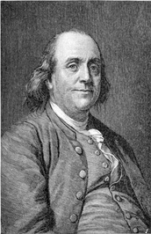
Develop a Succession Planning Policy
Does your Board have an official policy that details who is responsible, what needs to be done, how it will be accomplished, when it needs to be accomplished by?
“If you fail to plan, you are planning to fail!”
― Benjamin Franklin
Notes:
We are working to develop one and will share it in the next couple of weeks.

Slide 13
Role of the Governance Committee
Make sure that your Governance Committee has ample representation and fully understands its role.
They are much more than just king-makers. They should be working throughout the year to identify and recruit volunteers to fill vacancies, as well as to fill the complete compliment of leaders for the year to come.
It can be helpful to have newer and younger members, or people with large networks, in addition to your seasoned veterans on the committee to tap into new potential leaders.

Slide 14
How to Engage Potential Leaders
Take the time to get to know someone you think could be a good potential leader. Find common interests and pursuits that make you relatable to them. Getting to the “4th Question.”
Find out what their interested in or well-suited to in the NAIFA world. If someone hates politics, they will not likely make a good Advocacy Chair…you must find the person to fit the need, not force the person into the need.
Make sure that they are ready. People are very guarded of their time and asking too much, too quickly is a big turnoff.
Make sure they understand the commitment and work to keep it manageable.

Slide 15
Strategies for Succession Planning
Micro-Volunteering – Ask for them to do small, easy tasks that do not take much time to get in the habit of helping NAIFA.
Committee Members – Engaging Committee Members to have a positive experience and evolve to Committee Chairs and Board Positions.
Affiliate/Local Chapter Leaders – Cultivating leaders to continue their leadership journey.
Board Members – Ensuring Board Members value their experience and aspire to the Officer positions.
Replace Yourself – Every leader has an obligation to replace him or herself!

Slide 16
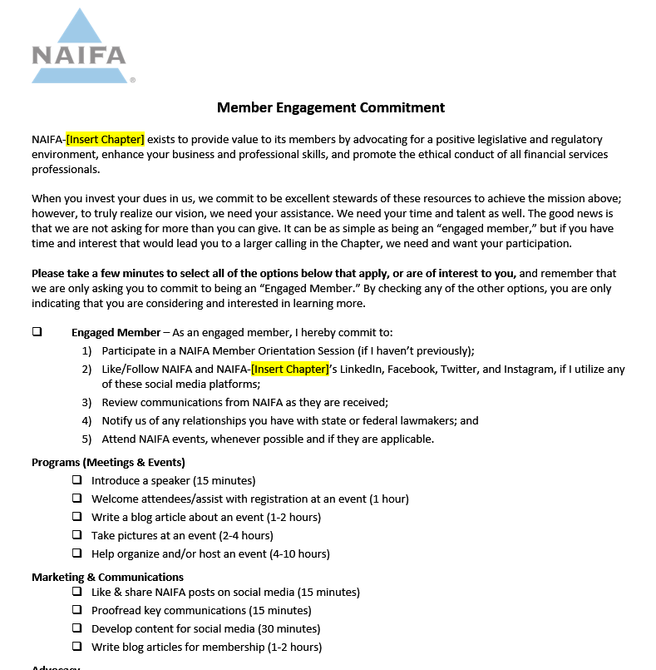
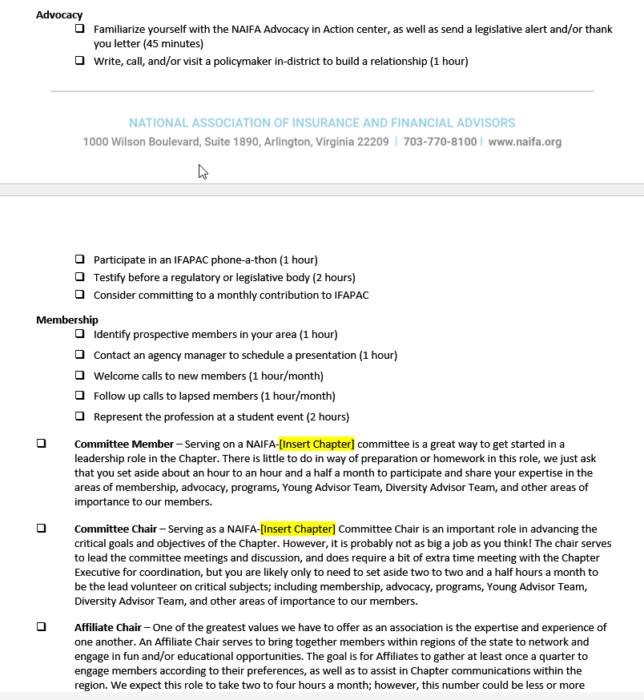
Tools & Resources – Member Engagement Form

Slide 17
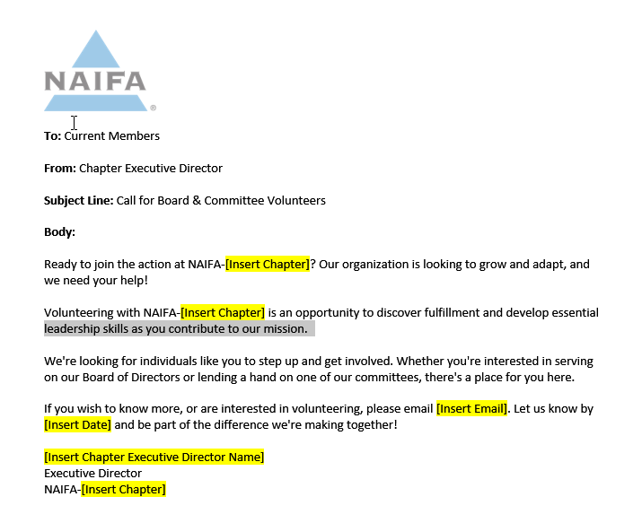
Tools & Resources – Call for Leaders

Slide 18
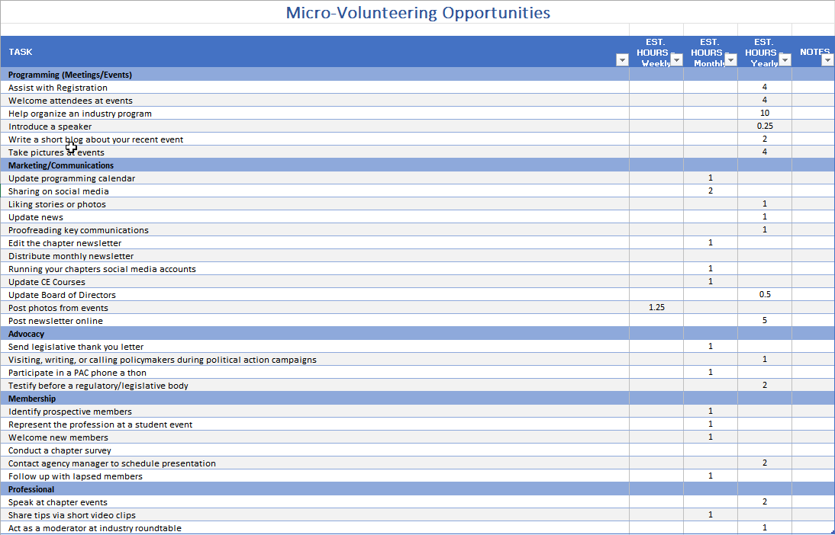
Tools & Resources – Micro-Volunteering Form

Slide 19
Training, Education, & Support
Position Descriptions
Clear Explanation of Required Commitment
Board Orientation
HQ Resources:
  Chapter Playbook
  Blueprint Leadership Training
  Certified Leadership Board
  Cohort Calls
  National Leadership Conference
Notes:
Use Guide to Engagement Requests as an example for commitment

Slide 20
Volunteer Appreciation
Regular Praise and Appreciation
Press Releases in their Communities and on Social Media
Recognition to Members
Annual Meeting Acknowledgement
Certificates of Appreciation
Awards of Recognition

Slide 21
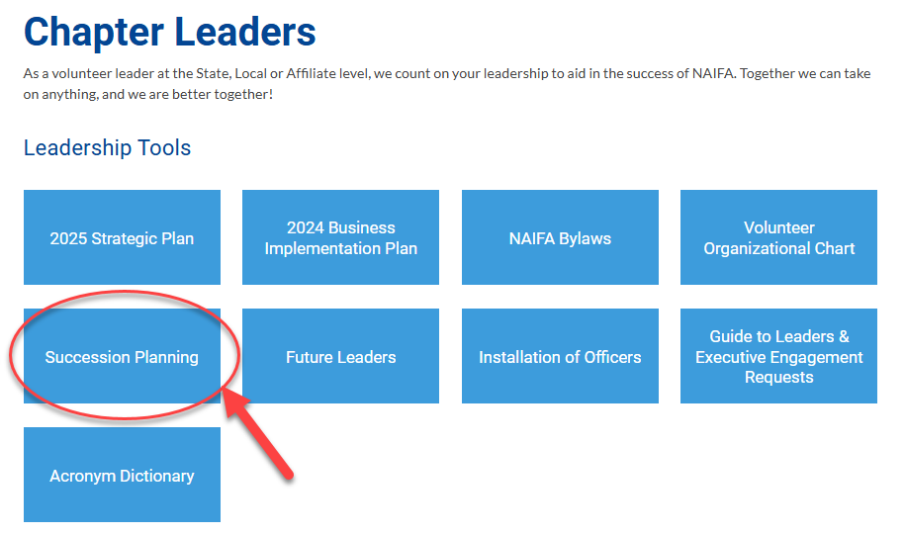
https://leaders.naifa.org/chapter-playbook-chapterleaders

Slide 22



Together We Can Take On Anything

