Slide 1



Slide 2

NAIFA’s
Membership
Promise

Slide 3
Advocate.
The protective advisor.

Slide 4
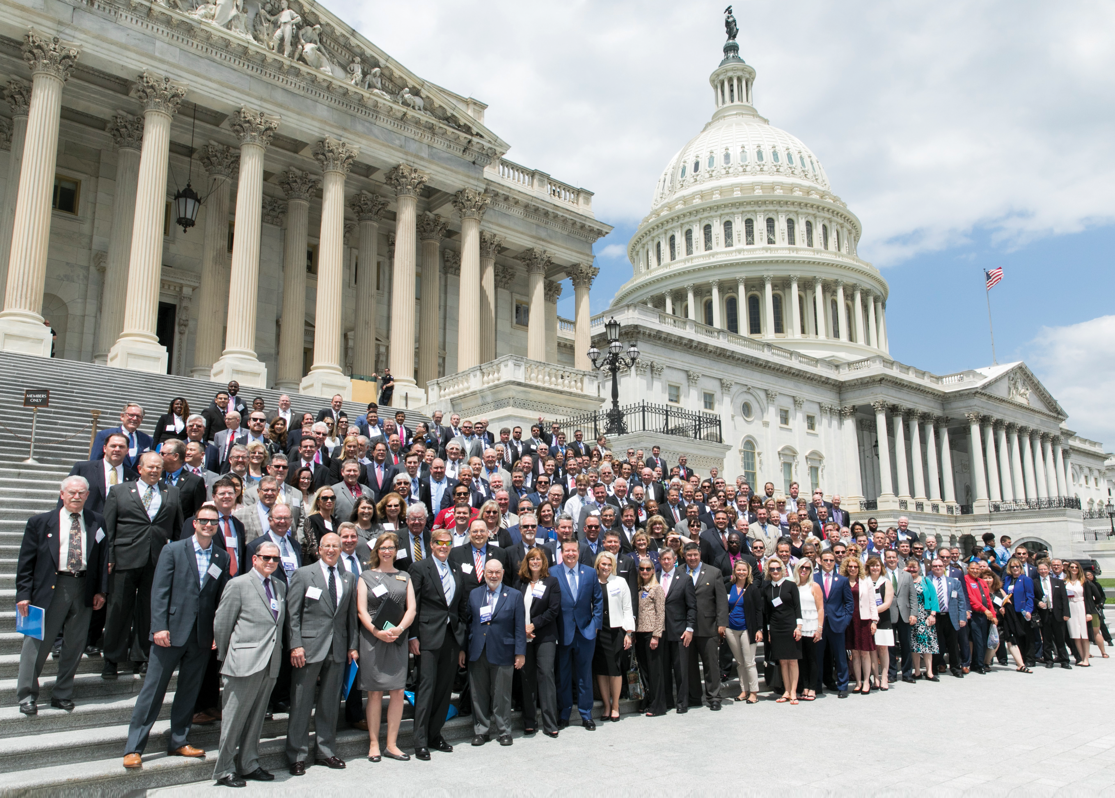
A NAIFA Member
In Every Congressional District
Federal Level
The Power of You.
The Power of Us.

Slide 5
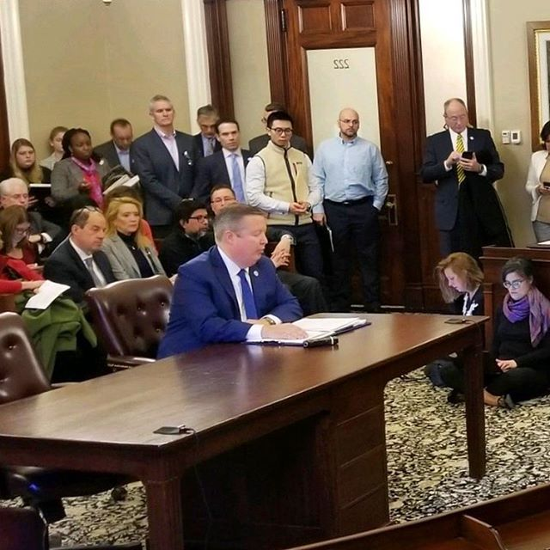
State Advocacy
Interstate Level
In Every State Capital
Political & Day on Hill Events
Division of Securities
NAIFA-MA & Kevin Mayeux, CEO

Slide 6
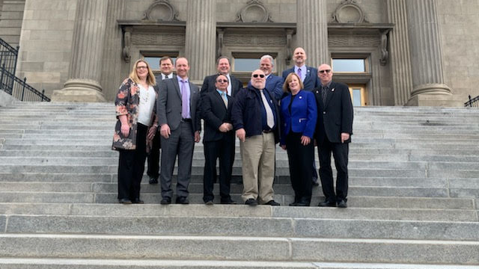
State Level
In Every State Capital
Political & Day on Hill Events

Slide 7


Slide 8


Slide 9
Educate.
The thinking advisor.

Slide 10

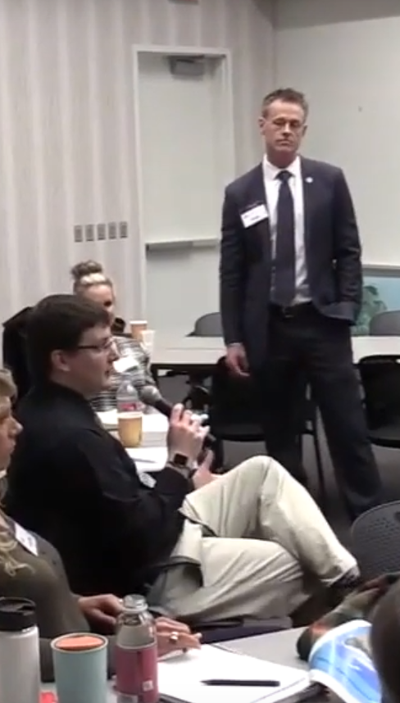
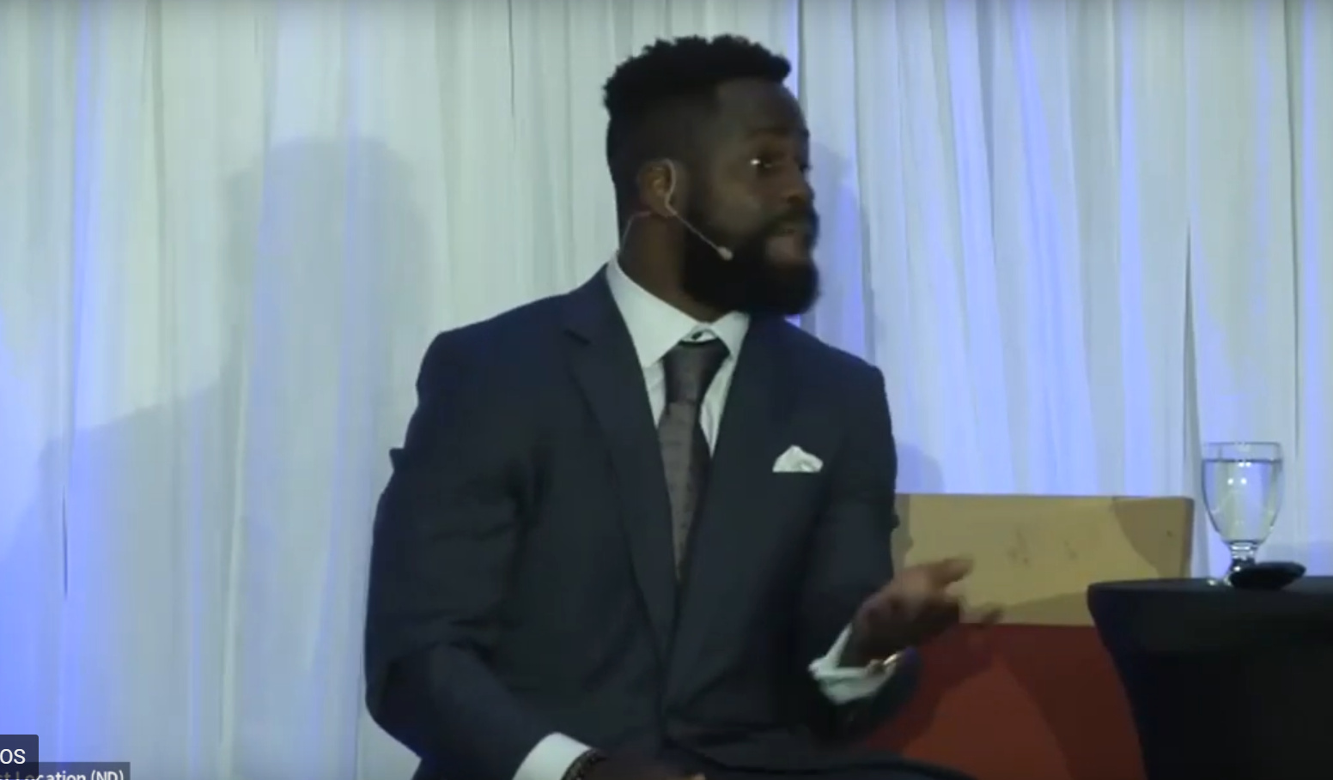
Watch Virtually or at a Watch Party
(when possible again)
One National Meeting per Month with Top Speakers
Pledge of Allegiance to Unite Us All for Serving MainStreetUSA

Slide 11


Slide 12


Slide 13



Slide 14


Slide 15


Slide 16


Slide 17

October 6-8, 2020 | Virtual

Slide 18
Differentiate.
The trusted advisor.

Slide 19

The NAIFA
Code of Ethics

Slide 20
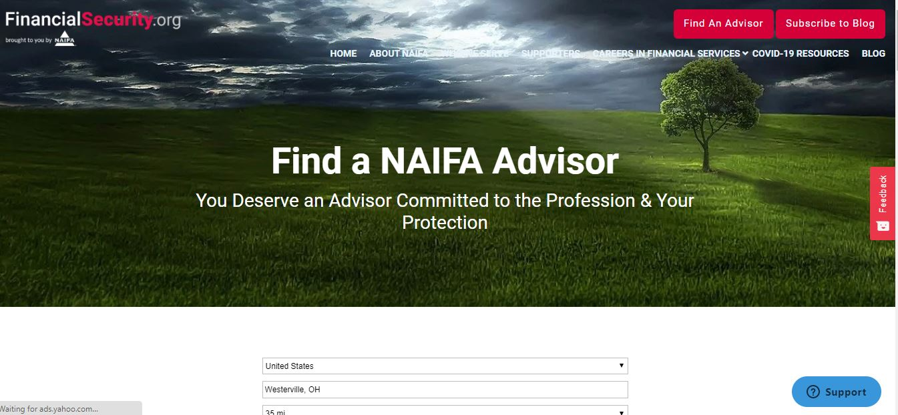

Slide 21
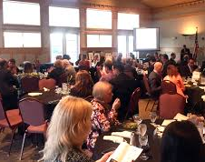
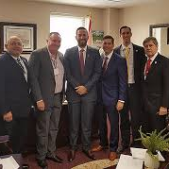

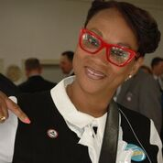
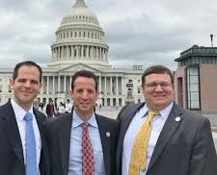
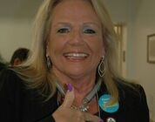
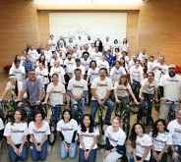
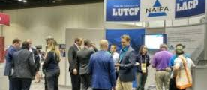

Connected
Community for Life

Slide 22


Slide 23

POWER OF THE PIN
Delivering on NAIFA’s Membership Promise
Notes:
[

Slide 24


Slide 25


Slide 26
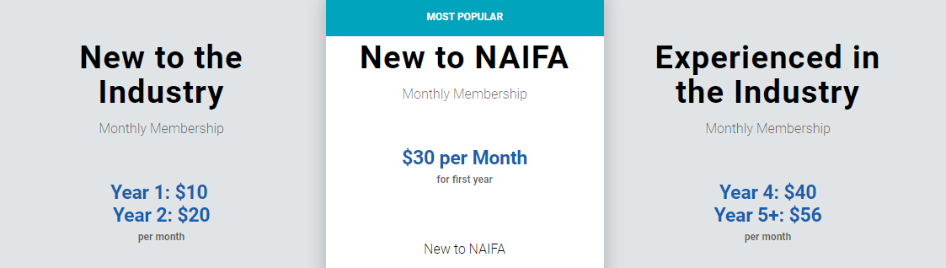
www.belong.naifa.org/fees

