Slide 1


Notes:
NAIFA is the National Association of Insurance and Financial Advisors. We are what the bar association is to attorneys. My name is _________. Like others in the audience today, I am a volunteer with NAIFA.
NOTE: Be sure you bring a “sell sheet” with you as a leave behind piece. Sheets can be found at https://leaders.naifa.org/marketing

Slide 2

NAIFA’s
Membership
Promise
Notes:
NAIFA makes a Membership Promise to
Advocate for you and your clients
Educate you so you can better serve your clients
Differentiate you from other advisors and agents
Along with NAIFA’s promise, I’m making my personal promise to you that NAIFA will always advocate for you, educate you and differentiate you.

Slide 3
Advocate.
The protective advisor.
Notes:
Advocate…NAIFA members are the protecTIVE advisor…NOT the protectED advisor…the protectIVE advisor.

Slide 4
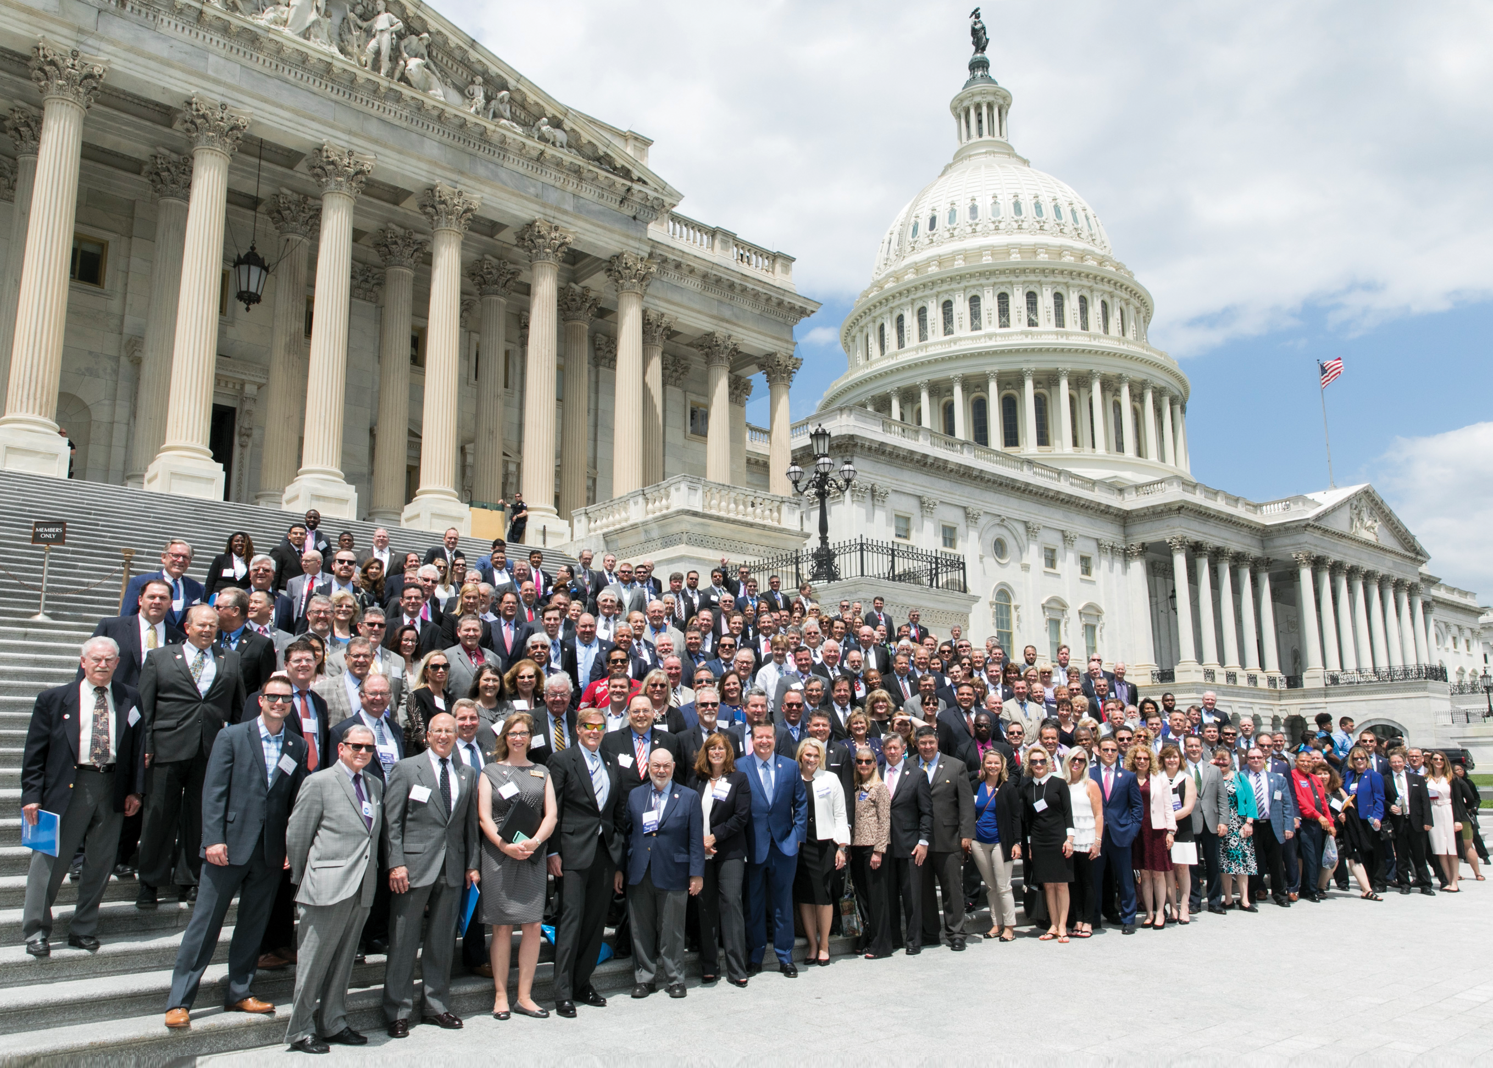
A NAIFA Member
In Every Congressional District
Federal Level
The Power of You.
The Power of Us.
Notes:
NAIFA protects our clients in Washington DC…all 50 state capitals…and NAIFA has a member in every Congressional District.
No other association in the insurance and financial services industry and operating in our space make this claim.
NAIFA combines and leverages the power of our individual members into the power of us to protect our clients no matter where they may reside.
In 2018, NAIFA sued the federal government over the Dept. of Labor Fiduciary Rule and we won.
In May of 2019, 600 NAIFA members went to Washington to lobby for passage of the Secure Act, and the very next week the bill passed the House. In December, NAIFA members, again, visited Washington. A few weeks later the Secure Act was attached to the spending bill and signed into law.

Slide 5
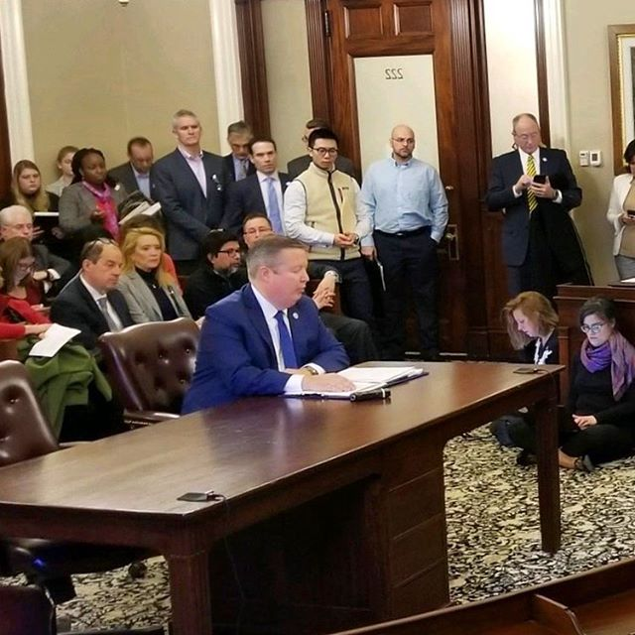
State Advocacy
Interstate Level
In Every State Capital
Political & Day on Hill Events
Division of Securities
NAIFA-MA & Kevin Mayeux, CEO
Notes:
What may occur in one state, could be replicated in another. Thus, the individual NAIFA Nation states are linked together in mutual support of each other. We are responsible to and for each other.
Here our national CEO, Kevin Mayeux, testifies before the Massachusetts Division of Securities in support of NAIFA-Massachusetts efforts to defeat a state-based fiduciary regulation.

Slide 6
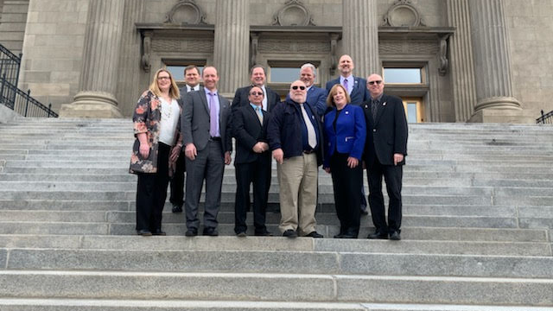
State Level
In Every State Capital
Political & Day on Hill Events
Notes:
Every state holds its own legislative day whereby members come together to meet with legislators. Each state has its own lobbyist who is working to protect your business and provides members with regular updates.
{The presenter should mention some recent state advocacy issues.}

Slide 7
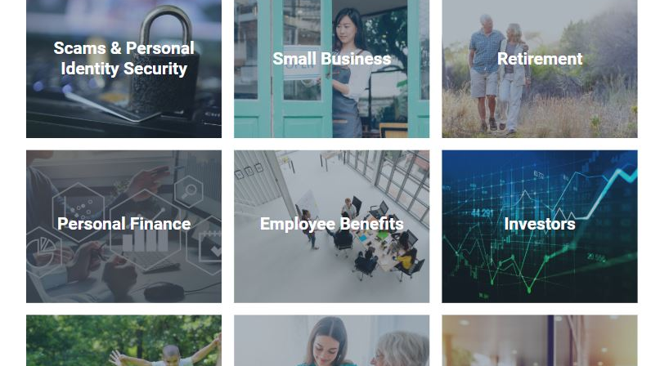
Notes:
When COVID-19 hit, our Government Relations team really stepped up to ensure that we could be of value to both members and policymakers. NAIFA quickly pivoted to build out resources for consumers and delivered these to state and federal legislators as a source of trusted materials to provide to constituents that were calling in with concerns that ranged from cybersecurity to identity fraud. Our work received public recognition from many state and federal policymakers for helping consumers during the transition into our new normal.

Slide 8
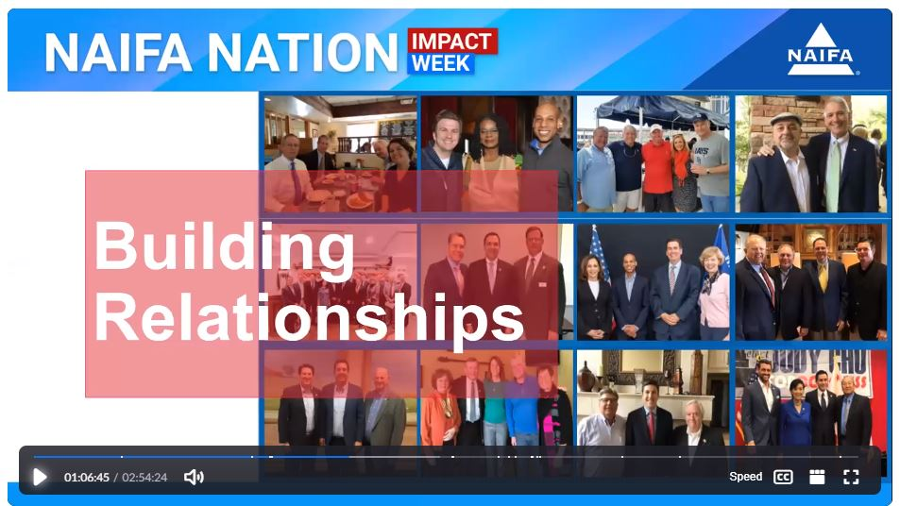
Notes:
We typically hold an annual legislative fly-in to Capitol Hill where we pre-arrange meetings by states for our members. Due to COVID-19, Capitol Hill closed, but NAIFA did not. Instead, we held a three-day virtual event called NAIFA Nation: Impact Week that had over 5,000 attendees. We held our Diversity Symposium, our Advocacy Day and a special Leadership Day with inspirational speakers to keep NAIFA Nation together.

Slide 9
Educate.
The thinking advisor.
Notes:
NAIFA members are the Thinking Advisor.
NAIFA Educates you in a way no other association does. We educate those who are new to the business and those who consider themselves elite advisors or Top of the Table MRDT advisors.
Our education is broken down into:
Education that develops your individual interpersonal & relationship sales skills
Education that develops your practice management skills so that you can be the best business owner possible
Education that provides insight into niche markets to help you grow your business through partnerships or specialization

Slide 10

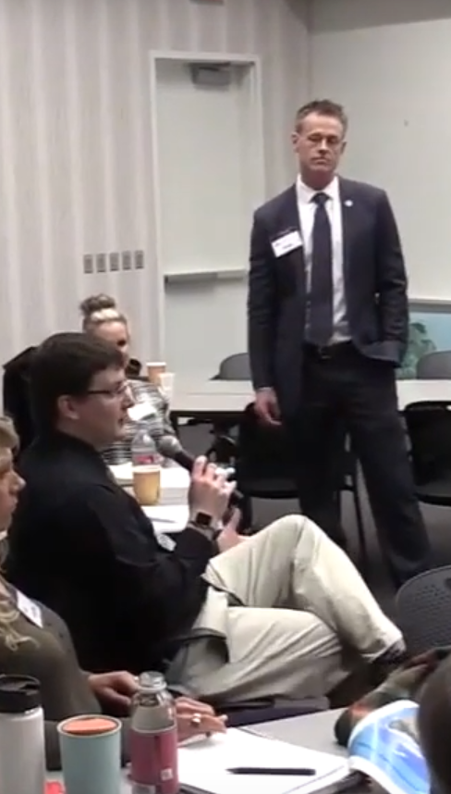
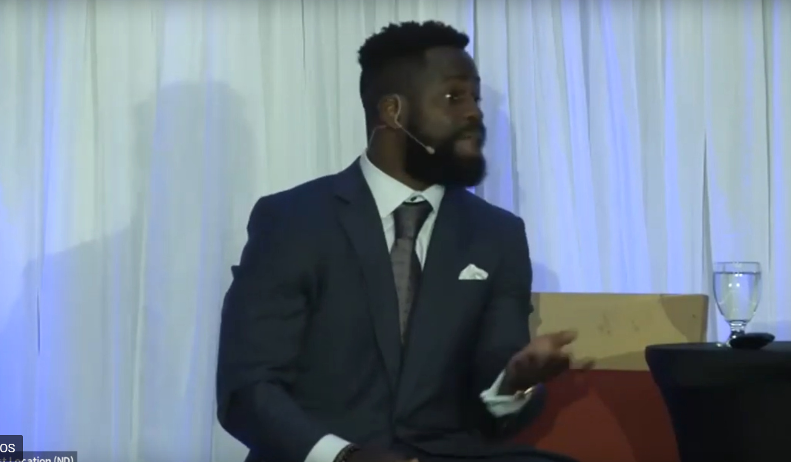
Watch Virtually or at a Watch Party
(when possible again)
One National Meeting per Month with Top Speakers
Pledge of Allegiance to Unite Us All for Serving MainStreetUSA
Notes:
NAIFA has a program called NAIFA Live where you can hear from top speakers around the country as part of your chapter’s monthly meeting. We conduct both NAIFA business and education in a new format that breaks down geographic barriers and allows all local and state chapters to participate as one.
You can dial in to the live event from your desktop or mobile phone or you can participate in a Watch Party in your area where you can watch the presentation and participate in group discussions about the topic.
If you can’t participate in real-time, the programs are all recorded so you can access them on-demand at your convenience.

Slide 11

Notes:
We have educational programming at the national, state and local levels much of which is typically held face-to-face. With the shutdown, NAIFA National stepped in with a series of amazing speakers that we featured in our Town Hall series. We started the series at the end of March and continued through June. To date, more than 20,000 people have been a part of our Town Hall series receiving needed inspiration and expertise from topics ranging from Paycheck Protection Program to prospecting using digital tools.

Slide 12

Notes:
There’s also the Big Ideas Webinar series that you can tune into live or on-demand for no extra fees to hear top notch speakers. We bring main stage speakers to you as a give back to the industry

Slide 13

Notes:
We also offer Centers of Excellence which are resource and thought leadership hubs of content and events focused on personal development, practice management and specialty areas.
The Talent Development Center focuses on providing personal development programs to serve every stage of a financial service professional’s career.
Within the Talent Development Center, we house our Award Programs and Certifications & Designations.

Slide 14
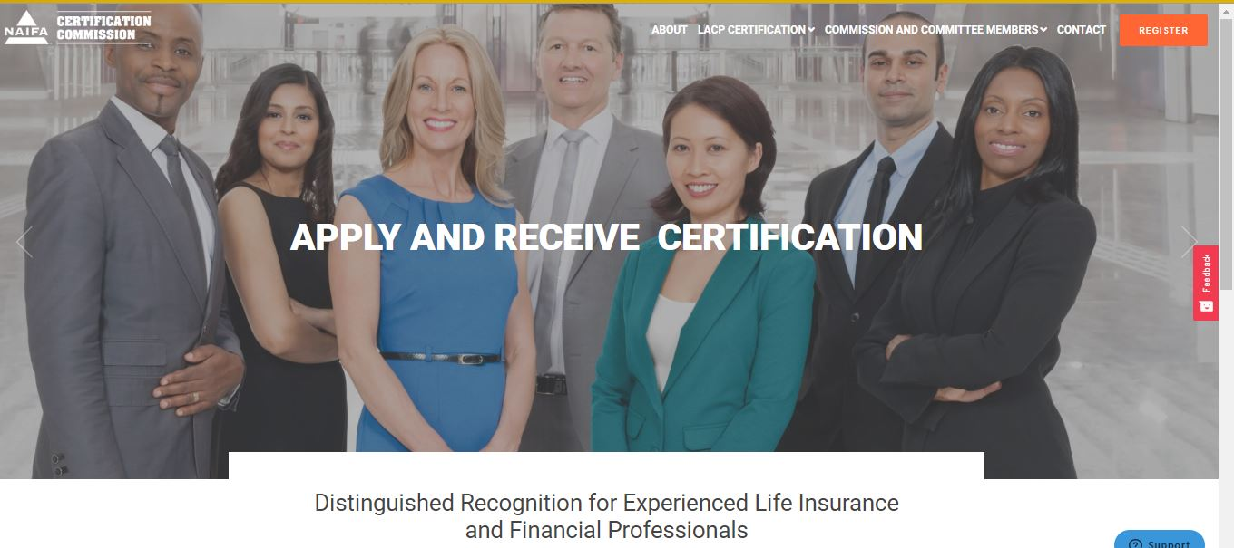
Notes:
NAIFA offers the Life & Annuities Certified Professional which is fully accredited and recognized by FINRA. Additionally, NAIFA offers the LUTCF designation and supports the Certification for Long-Term Care designation as well.

Slide 15
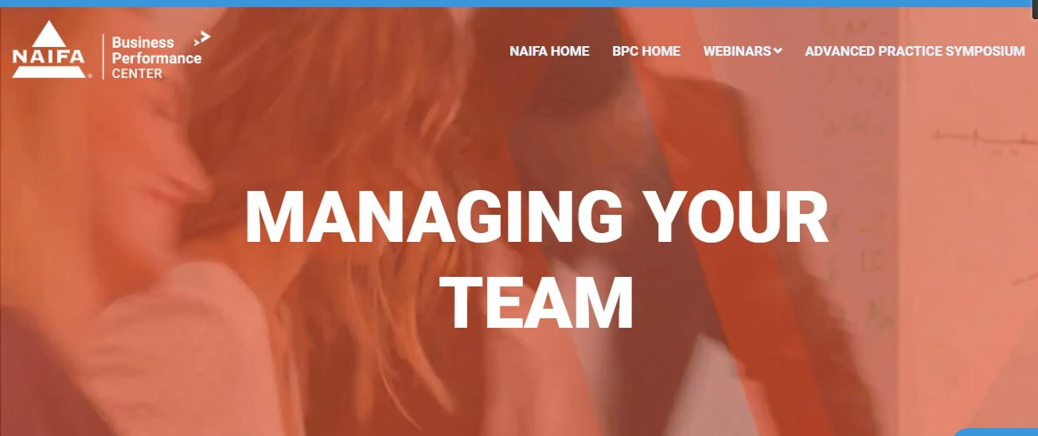
Notes:
The Business Performance Center is another Center of Excellence that focuses on best practices in building your business. Here you will find content and events focused on all aspects of practice management. The Business Performance Center also houses our Advanced Practice Symposium which is a special initiative with the Society of Financial Service Professionals to cover advanced planning topics.

Slide 16
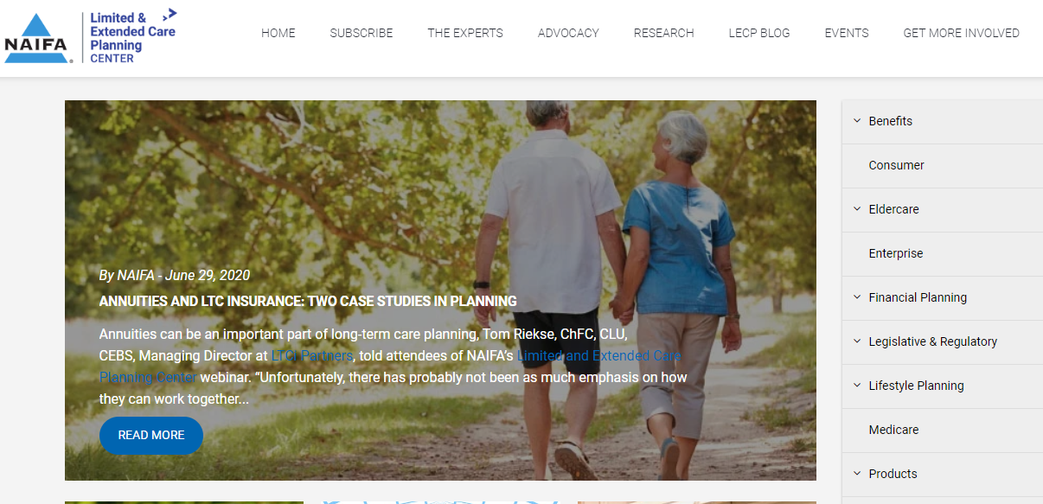
Notes:
Our Centers also included specialty centers. Our Limited & Extended Planning Center is a one-stop shop for all things long-term care and offers its own content, set of experts and event series to help more financial advisors have the confidence and connections to provide clients with comprehensive planning.

Slide 17

October 6-8, 2020 | Virtual
Notes:
Finally there is the annual Performance + Purpose conference which is the educational event of the year. This year we’ve moved to a virtual platform, but will continue to bring you top names and keynote speakers that cover a wide range of topics.

Slide 18
Differentiate.
The trusted advisor.
Notes:
Differentiate.
How are NAIFA members different?
There are various studies that have been done…not by NAIFA, but by others…that show that NAIFA members earn $10,000 to $43,000 more than non-members. Why is this?
NAIFA members are the trusted advisor.

Slide 19
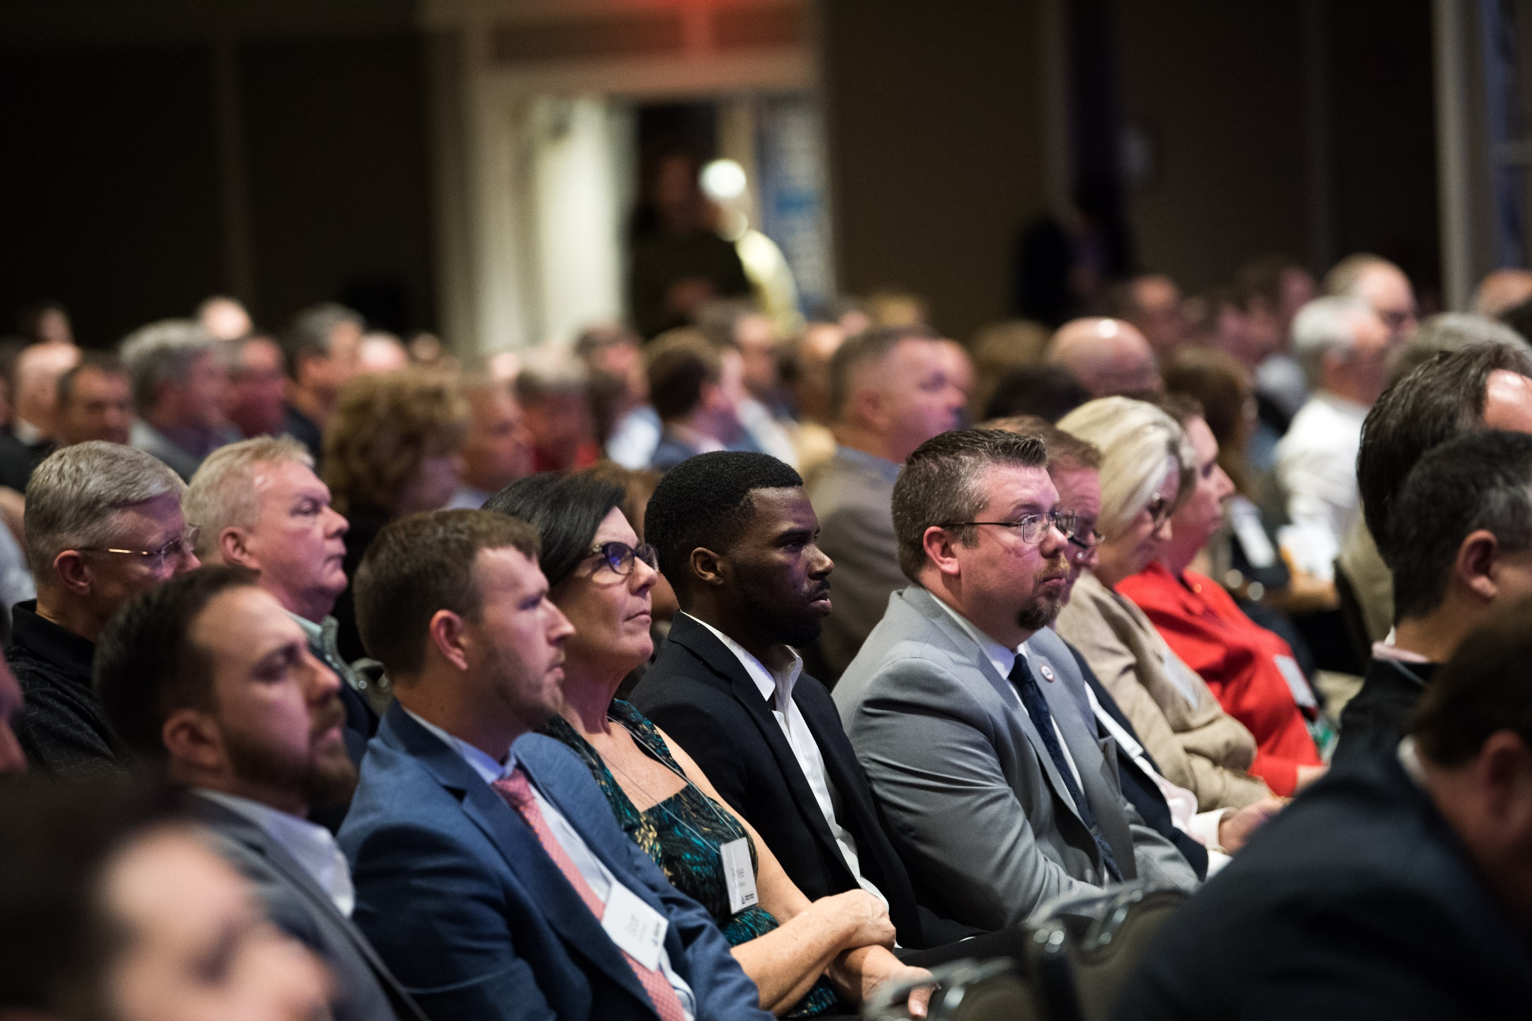
The NAIFA
Code of Ethics
Notes:
Few associations operate with a code of ethics, almost none include a best interest statement.
NAIFA membership carries an obligation to abide by NAIFA’s Code of Ethics, which requires agents and advisors to always serve their clients’ best interests.
Who here would not take that pledge?
Who here would not stand up and say I always put my clients’ best interests ahead of my own?

Slide 20
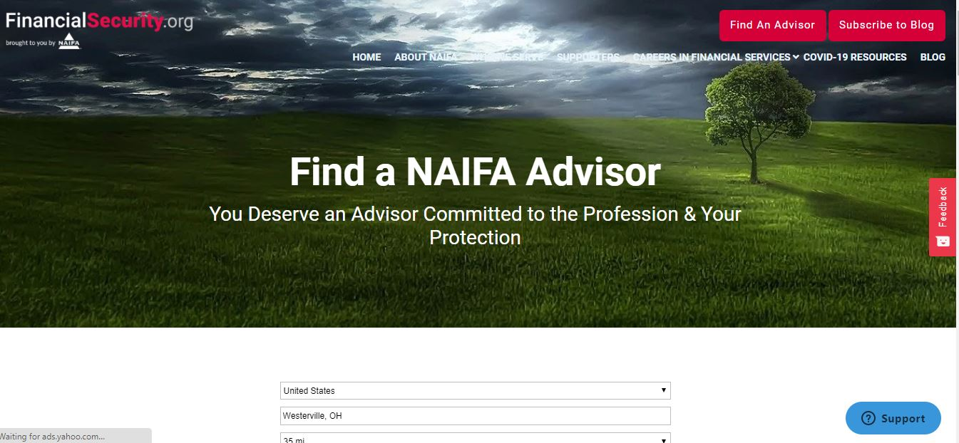
Notes:
Our consumer site, financialsecurity.org, lists every member in good standing so that consumers can identify you as a professional who belongs to your professional association and is a member in good standing, abiding by a Code of Ethics.
We run national marketing campaigns to highlight our consumer site which also features content and events. Within our consumer initiative, you will also find our Financial Literacy program and our initiative to raise the profile of a career in financial services to consumers. Our members volunteer to give financial literacy virtual sessions and provide videos of a “Day in the Life” to provide to consumers to get an inside look as to what advisors do.

Slide 21
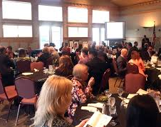
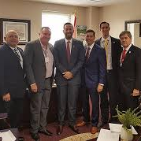

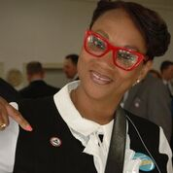
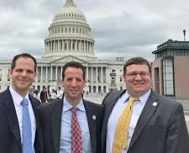
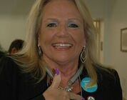
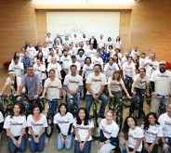
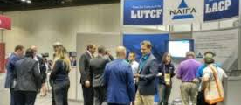

Connected
Community for Life
Notes:
NAIFA members are connected to a community of like-minded individuals. NAIFA members openly share their ideas and best practices with one another. NAIFA members service their community via NAIFA sponsored events.
[Add a personal story about your connection to the community. Share a story about how a member gave you an idea that helped you close a case or an experience you’ve had through a community service project working alongside your fellow members]

Slide 22

POWER OF THE PIN
Delivering on NAIFA’s Membership Promise
Notes:
[Always have your NAIFA pin on! Point to it!]
See this pin?
It is a symbol that
I advocate for my clients.
I am committed to educating myself to better serve my clients
I always put my clients’ interest before my own
On a personal note, I wear this on every client meeting because my clients often ask me about it….when they do, I say:
“I am a member of the National Association of Insurance & Financial Advisors, my professional association. As a member, I take a pledge to always act in my clients’ best interest. It’s like the AMA for doctors…you wouldn’t go to a doctor that wasn’t a member of the AMA, would you?” I also say, “Over the next few weeks, you will decide whether you want to work with me or not as your financial advisor…if you decide not to work with me, I encourage you to go to advisorsyoucantrust.org and find another NAIFA member who has made the same pledge as I have to always put your interests above their own”.

Slide 23

Notes:
NAIFA celebrates its 130th Anniversary this year. We represent the lifeblood of an industry that contributes to the financial security of 90 million American families. Our members love what they do and love serving Main Street USA.

Slide 24

Notes:
I would like to ask you all a question. What value would you place on what I have just described? Many tell me $100 a month. We at NAIFA have a career friendly fee structure designed to be affordable regardless of your time in the industry.

Slide 25
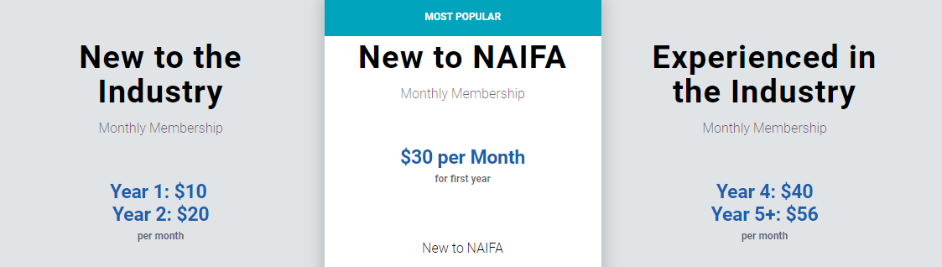
www.naifa.org/join
Notes:
Now take out your phone and go to www.naifa.org/join. Join today and on Monday, your name will be posted to social media and our website. Your benefits will begin immediately. Should you join today, I would be happy to present you with your NAIFA pin.

