Slide 1

Creating Local Engagement for the Expanded NAIFA

Slide 2
Topics for Today’s Presentation
Redefining Local Engagement in a “Post” Environment
What Do Your Members Want?
Why Do They Want It?
How Well Are You Delivering What They Want?
What if We Already Tried That?
How Do We Add Value?
Leveraging Multi-Disciplinary CE
Where to Start with Multi-Disciplinary CE?
Identifying Potential Speakers
Identifying Compelling Topics
Partnering for Promotion
Leveraging for Membership

Slide 3

Our Environment – Three “Posts”

Slide 4
“Post” QME Reorganization
Required that Local Chapters who lacked the size and resources to support administrative costs convert to Affiliates.
Resulted in many long-serving and tired volunteers taking the opportunity to step back from local engagement activities.
We have had to remap and rebuild our entire local service area model over the last few years.

Slide 5
“Post” COVID Culture Shift
COVID brough an unanticipated, immediate, and prolonged halt to our ability as a community to come together, meet, and network.
Given the isolation and social distancing, people became more technologically dependent and advanced, learning to do virtually what they preferred in-person previously.
Despite increased comfort, fatigue also set in.

Slide 6
“Post” FSP/Life Happens Merger
Merging three unique organizations, memberships/audiences, and cultures has been a significant undertaking that has consumed much of the last year and a half.
The primary value of FSP’s joining the NAIFA community is its revered continuing education for all advanced practices in the financial services space – take advantage of it!

Slide 7
What Do Your Members Want?
NAIFA members routinely report through direct discussions and our annual member survey that they highly value the opportunity to network with other members in-person at the local level.
Of those who report why they are leaving NAIFA, the “unavailability of local meetings” is the second highest rated reason for engagement.
In essence, it is NOW (more than ever) time to get back to holding local meeting.

Slide 8
How Well Are You Delivering What They Want?
Most of our 29 Local Chapters hold monthly programming and in-person networking opportunities.
Last year, we started collecting data on Local Affiliate programming, logging 411 affiliate in-person events for Q1-Q3 2023 across our 229 affiliate areas.
This year, that increased to 460 affiliate in-person events for Q1-Q3 2024, a 12% overall increase.
BUT…we can and must do better!

Slide 9
What if We Already Tried That?
One of the most prevalent reasons that organizations do not try something is because it has been tried before. This fails to consider that the timing may not have been right, the marketing could have been off, or maybe you gave up too soon.
In a post-COVID, more virtual world with less time availability, members want opportunities to engage with maximum value at minimal time investment.
Make sure that it is simple, inexpensive, and fun to engage!

Slide 10
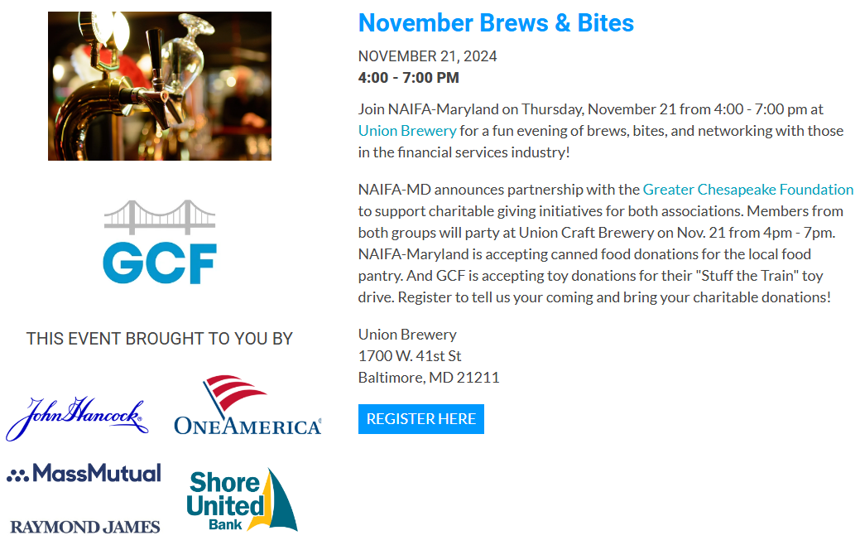
Case Study: NAIFA-Maryland
Started with four Board members meeting after work for a beer.
They got two more after four months of just them.
This afternoon they will have 5 sponsors and 75 attendees, two-thirds of which are future members!
Notes:
- Can we do a breakfast? Eggs & Issues

Slide 11
How Do We Add Value?
Keep it short and simple. Usually, an hour or two will work.
Make it easy and welcoming to participate.
Make it inexpensive and make sure there is more than enough value to justify the investment of time and money.
Make it fun – social networking events are valuable.
Avail yourself of the “big tent” of professional disciplines that NAIFA now represents (attorneys, CPAs, trust officers, etc.).
Add compelling and interesting continuing education.

Slide 12
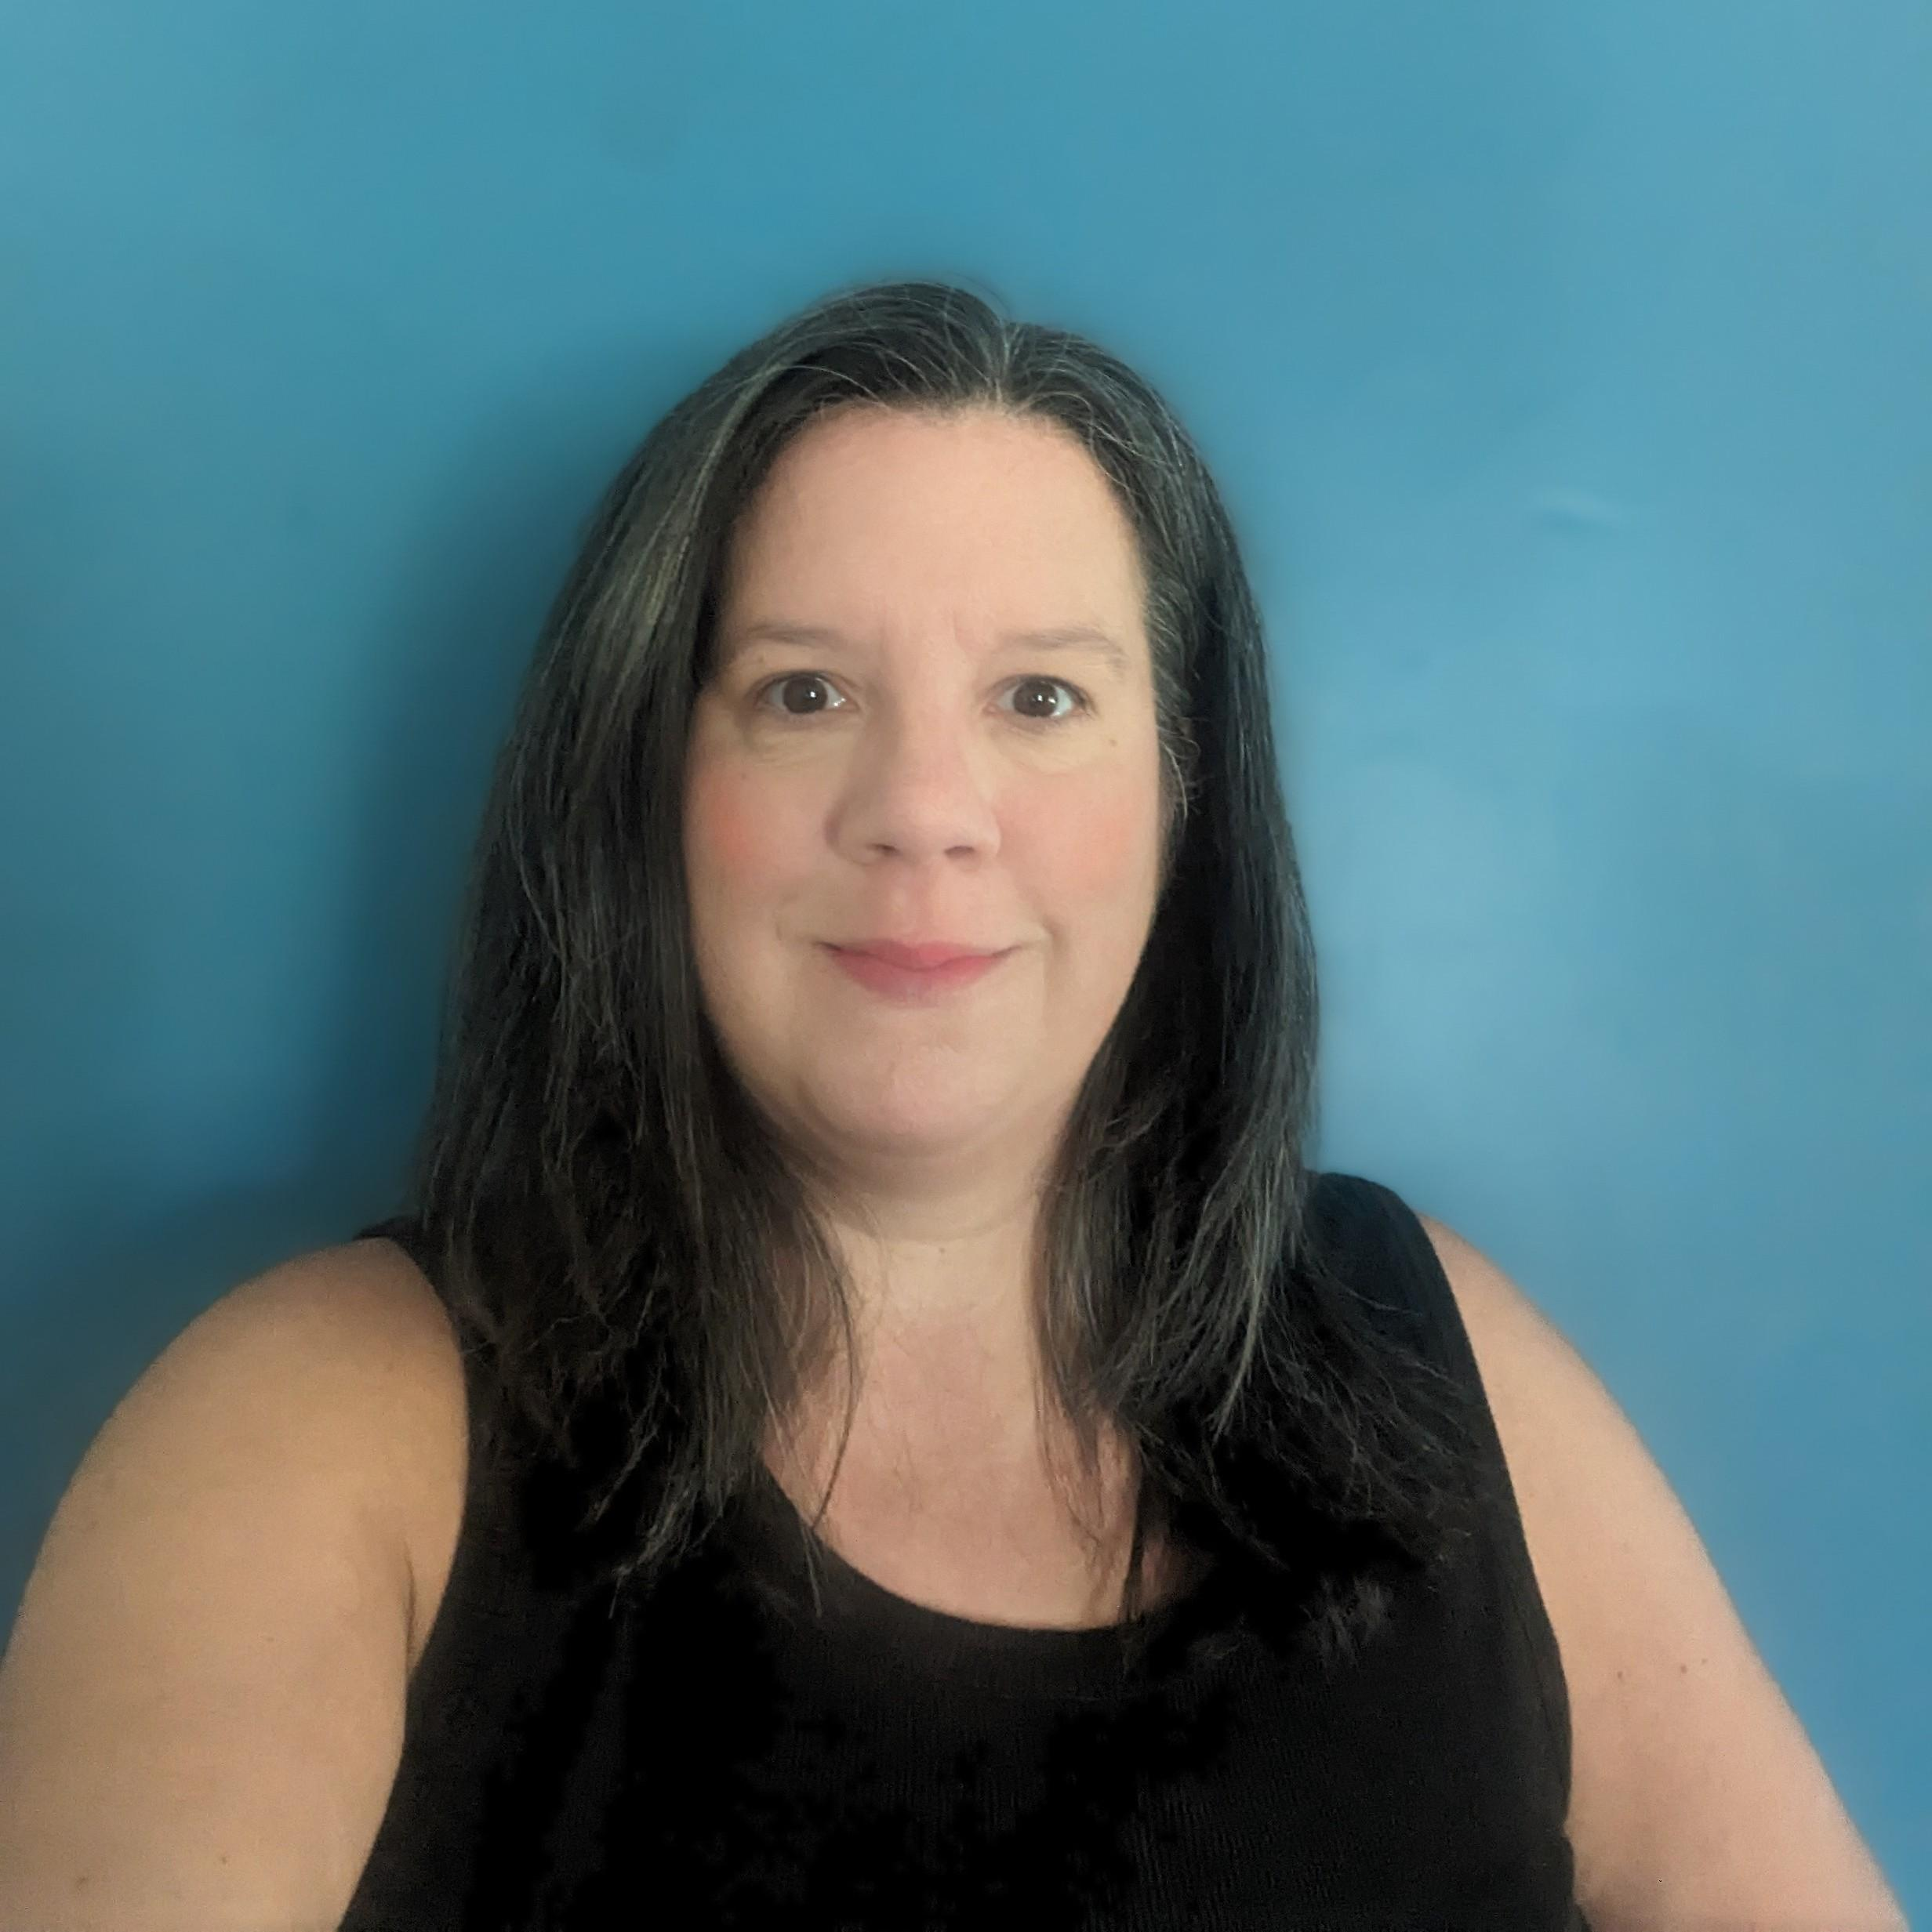
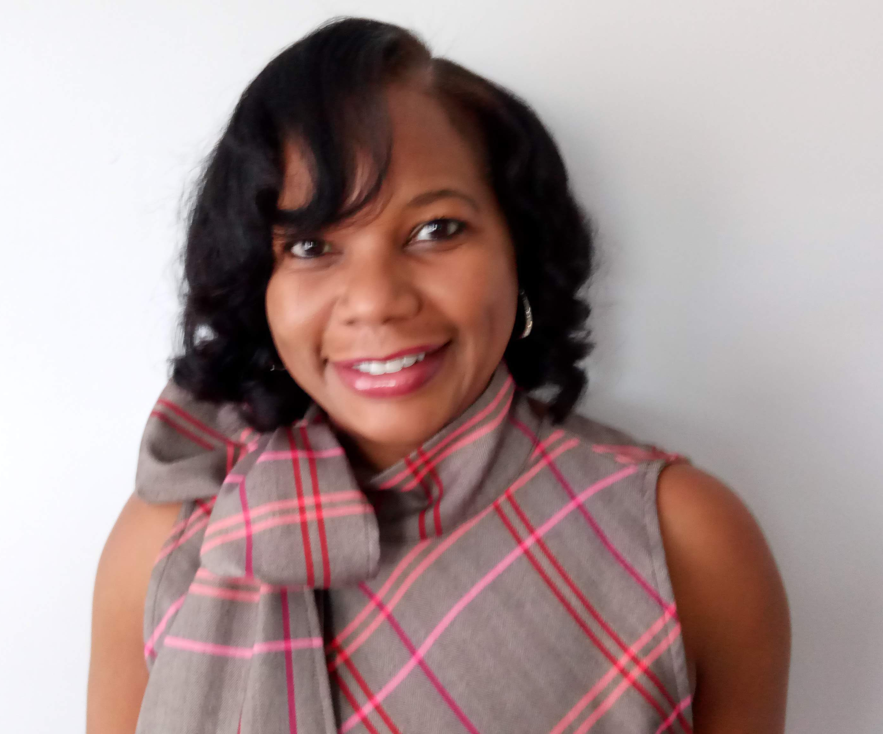
Leveraging Multi-Disciplinary CE
Where to Start with Multi-Disciplinary CE?
Identifying Potential Speakers
Identifying Compelling Topics
Partnering for Promotion
Leveraging for Membership
Patti McFadden
VP of Professional Development
Caprice Evans
Continuing Education & Professional Development Coordinator

Slide 13



Together We Can Take On Anything

